Slide 1
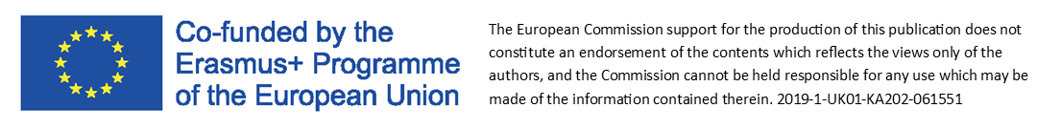
Module 1
Why does lean innovation matter?

Slide 2

LEAN INNOVATION
ARE YOU INTERESTED IN:
Efficiency improvement?
Increased customer satisfaction?
Financial savings?
Lean innovation
is the answer!

Slide 3
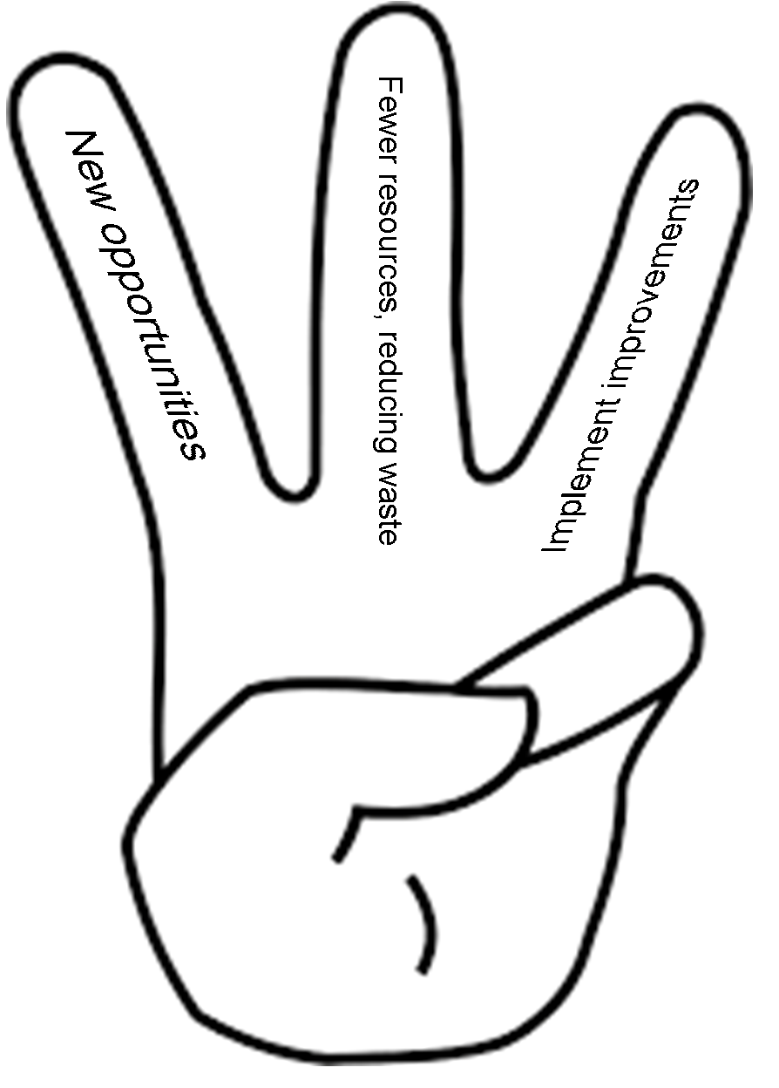
LEAN INNOVATION FOR EVERYONE
STILL HESITATING?
You probably think that implementing innovations is an expensive and complicated process.
GUESS WHAT…
LEAN INNOVATION
means a quick and cheap process!

Slide 4

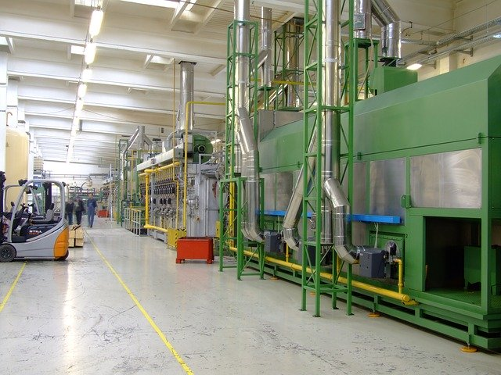

LEAN INNOVATION FOR EVERYONE
Micro and large businesses implement lean innovations, especially in such hard times like the Covid-19 pandemic.
Every business can implement lean innovations, regardless of their size!

Slide 5

LEAN INNOVATION - EXAMPLES
EXAMPLES
MICRO COMPANY
Promoshop is a small promotional merchandise company operating in Poland, which started to sell personal protective equipment, such as masks and helmets, on which one can also promote the company. This way the company was able to survive the Covid-19 lockdown
LARGE COMPANY
In March 2020, PKN Orlen, the largest Polish oil refiner and petrol retailer, started large-scale production of hand sanitizers to meet the increasing demand in the country due to Coronavirus outbreak.

Slide 6

LEAN INNOVATION - EXAMPLES
Butterfly Advertising Agency .
Website: https://promoshop.pl/
LinkedIn: https://www.linkedin.com/company/gadzety-reklamowe
Size of the company:
Micro company - 7 employees
Company profile (range of activities/products/services):
The company provides advertising services, with focus on a wide range of premium business gifts.
The agency designs, manufactures and sells gifts with imprints to B2B sector (companies, schools, public sector) in Poland.
It is one of the leading companies in this sector with 19.000 customers on-line in past 22 years.
Maciej Borowy - the owner

Slide 7


LEAN INNOVATION - EXAMPLES
Butterfly Advertising Agency
In March 2020, the company faced a critical period because of COVID-19 lock down.
Customers immediately stopped orders and enquiries for advertising gifts, as all the events were cancelled.
The company undertook market research about its customer needs in this unexpected situation.
As a result, the agency quickly decided to implement a new offer to on-line shoppers: personal Protective Equipment (printed face masks, gloves and disinfectant liquids for business customers and its employees).
This was crucial for keeping both employment and turnover unchanged during lock down time.

Slide 8
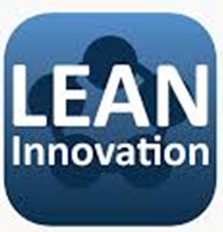
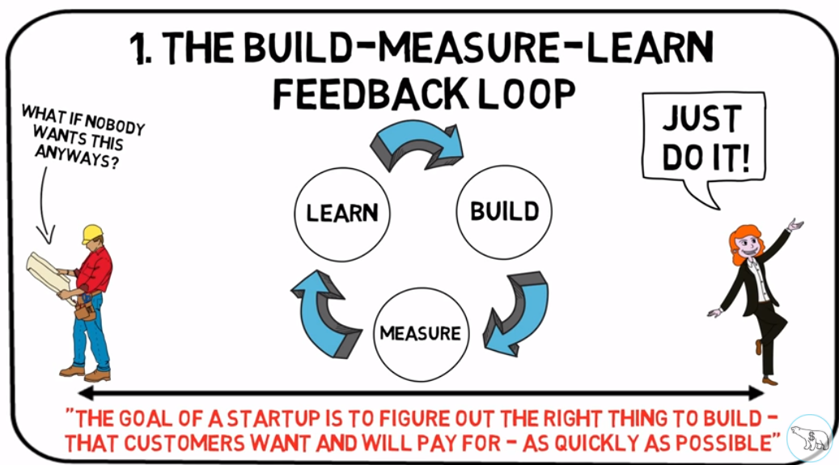
LEAN INNOVATION – WHAT IS IT?
But hey… what is this exactly?
Lean Innovation is the ability to:
quickly and with fewer resources
develop, prototype, learn, validate, improve
business solutions
Watch
“The lean start-up” by Eric Ries (13mins)
You Tube Link
and
create innovations

Slide 9
LEAN INNOVATION – BASIC PRINCIPLES
Check the Lean Innovation- basic principles
experiment
get customer feedback
minimize waste
continuous improvement
Remember!
- Entrepreneurs are everywhere
- Entrepreneurship is management
*The lean innovation process including these principles will be discussed in later modules

Slide 10
LEAN INNOVATION
Lean Innovation
is based on
Lean Thinking
The lean innovation system:
is the systematic application of lean thinking principles
to product or process innovation and development

Slide 11
LEAN INNOVATION – 5 STEPS
You need to follow only 5 steps to implement lean innovation!
Identify the Value
Map the Value Stream
Create Flow
Establish Pull
Seek Perfection

Slide 12
LEAN INNOVATION – THREE PILLARS
What can you do to implement lean innovation ?
The 3 Pillars of
Lean Innovation
LEAN INNOVATION
Design thinking
                tools and methodologies to really understand the opportunity and how You can accelerate it into something that is truly innovative
Lean Start-up
methodologies - what can we learn from the best start-up companies that have few resources but still manage to create things like UBER
Lean Methods and Practices
lessons from large companies
Lean methods & practices
Design thinking
Lean
start-up

Slide 13

LEAN INNOVATION – DESIGN THINKING
Let’s start with DESIGN THINKING.
Design thinking is a customer-centric approach to brainstorming new ideas and solving problems.
It puts the emphasis on the CUSTOMER.
By observing end users in their natural environment, companies can better understand their customers’ needs and, in turn, uncover unique insights that could lead to new business opportunities.
All steps of DESIGN THINKING are explained in Module 4.
Watch
“How it works: Design thinking” (6 mins)
You Tube Link

Slide 14
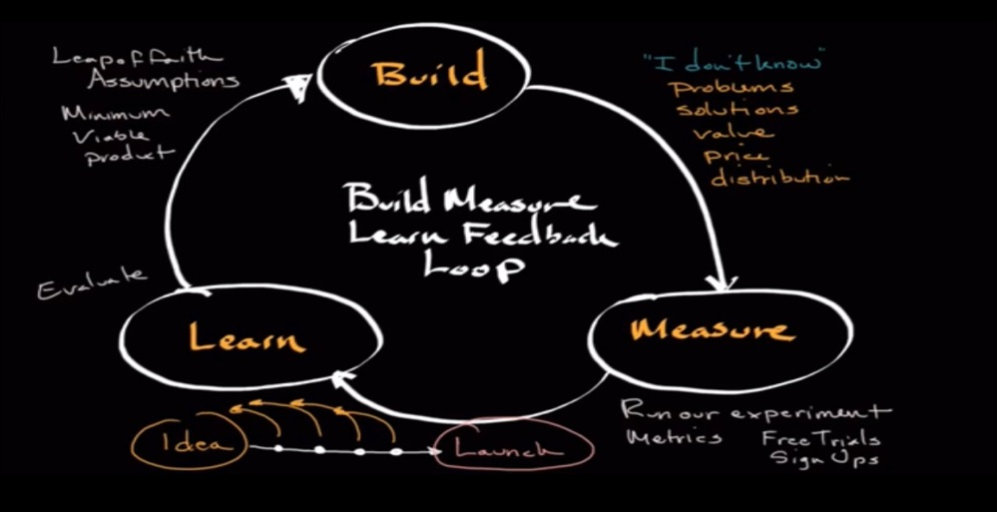
LEAN INNOVATION – LEAN STARTUP METHOD
Lean Startup Method
(you might have heard about
MVP - Minimum Viable Product)
The Lean Startup approach is centered on a “build, measure, learn” feedback loop. The goal is for companies to build a minimum viable product (MVP), or the most stripped down version of a product or website that early users can test.
An MVP should have the core features that make the product work, but serve as more of a guide for future development. By placing an MVP in users’ hands, companies can quickly discover what’s working and what’s not and iterate based off that feedback. They then eliminate waste and build a product they know customers actually want.
The Lean Startup method, popularized by Silicon Valley entrepreneur Steve Blank, builds off concepts introduced in design thinking and enables companies to “quickly, and with fewer resources, develop, prototype, learn, validate, and improve business solutions”
Watch
“The Built-Measure-Learn Feedback Loop/ New venture launch”
You Tube Link

Slide 15
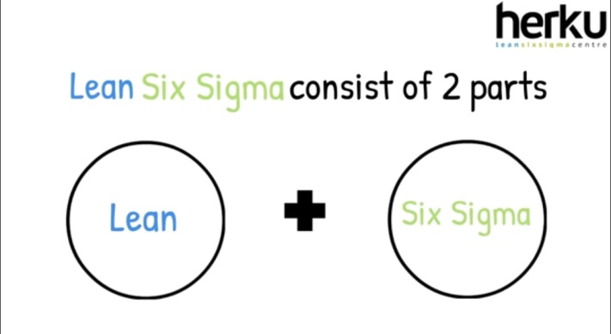
LEAN INNOVATION – LEAN PROCESSES
Lean Processes
the reduction of waste
continuous improvement
allow innovation teams to tear down some of the bureaucracies and processes that inhibit innovation
This could include minimizing the number of meetings employees are in, to simplifying the steps projects need to go through for approval, to employing lean methods such as Six Sigma.
Six Sigma is a method focused on improving business processes and performance by eliminating the causes of errors that lead to defects in a product or service.
First adoption of Six sigma methodology - Motorola
Motorola first adopted the methodology in the mid-1980s as a way of standardizing defect measurement to drive improvements in manufacturing.
Watch “Lean Six Sigma Explained” (2 mins)
You Tube Link

Slide 16

LEAN INNOVATION – THREE PRINCIPLES
The three E’s are a good way to start thinking about Lean Innovation
Watch 3 E’s of Lean Innovation” (1 min)
You Tube Link
”3xE” of Lean Innovation:
Empathy
Experiments
Evidence
Empathy - design thinking holds the empathy portion – this allows organizations to truly pull back the curtain on their customers and understand their desires and needs. Where design thinking ends, Lean Startup begins.
Experiments - While design thinking focuses on empathy, Lean Startup takes it a step further into the realm of testing assumptions through rapid experimentation. This involves brainstorming, creating a hypothesis, defining a key metric and running a specific experiment to validate the product or service.
Evidence - The data derived from above tests, plus the insights gleaned from ongoing empathy work form the evidence. Evidence informs and helps guide the entire decision making process.

Slide 17
LEAN INNOVATION vs. TRADITIONAL INNOVATION
Lean innovation is faster compared to traditional innovation and here is why:
TRADITIONAL INNOVATION
50 Page Business Plan (IMPLEMENTATION Driven)
Focus is on the SOLUTION
Specify ALL features of the Product
Build LAUNCH, SELL
COMPLETE Product Built
Improvements Identified by MANAGEMENT
COMPLEXITY is the Norm
Product Management (Prepare Offering, Step by Step Plan)
Failure by EXCEPTION
Innovation Speed: MEASURED (uses Complete data)
LEAN INNOVATION
1 Page Lean Canvas (HYPOTHESIS Driven)
Focus is on the PROBLEM
Get CONTINUOUS CUSTOMER Input
Build, MEASURE, LEARN
INCREMENTAL Build
Improvement Identified by WORKERS
SIMPLICITY is the Norm
CUSTOMER Development (get out of office and test hypothesis)
Failure is EXPECTED
Innovation Speed: RAPID (uses Good Enough data)

Slide 18

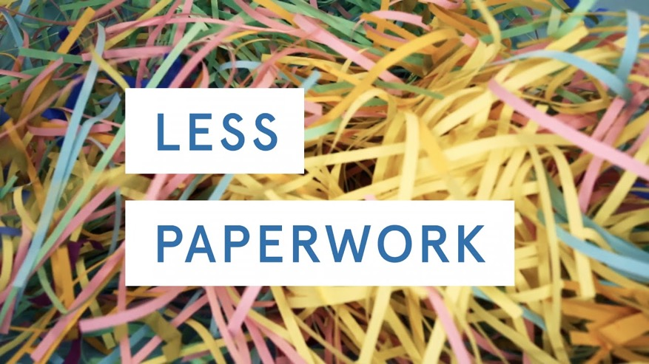
LEAN INNOVATION - BENEFITS
How can you benefit from Lean Innovation?
FEWER DECISION POINTS
Applying the principles or methodologies of Lean innovation throughout your business helps reduce the risk of producing products or services no one wants, and allows you to focus capital and resources to ideas that really create value.
Main advantages of Lean innovation management:
less paperwork
targeted and effective meetings
fewer decision points and gates
abandonment of milestone management
(historically a common trait regardless of industry)
MILESTONE
MANAGEMENT
EFFECTIVE
MEETINGS

Slide 19
LEAN INNOVATION - EXAMPLES
Lean innovation examples
ING
AIA
Medical device company
Key takeaway
Key takeaway
Key takeaway
Lean innovation is the ability to quickly, and with fewer resources, develop, prototype, learn, validate, and improve business solutions
Aggressive sprints and high levels of experimentation and customer interaction can drive impact quickly
Realizing that it’s not just about building new products, but about tying innovation to growth allows organizations to answer the question:
“How do we apply lean innovation to what we already have in order to discover new opportunities and reduce waste in the commercialization of our products”

Slide 20

LEAN INNOVATION - EXAMPLES
EXAMPLE
Pudding Row – a shift of business model
in response to COVID19
IRELAND
Pudding Row Sligo
Website: https://puddingrow.ie/
Facebook: https://www.facebook.com/PuddingRowSligo
Image - Sligo Food Trail

Slide 21
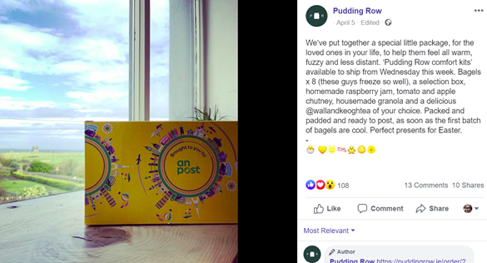
LEAN INNOVATION - EXAMPLES
Company profile
Founded by Dervla James, Pudding Row café is a breath of fresh air to West Sligo, serving up freshly baked goods, all-day breakfast, salads and delicious lunches. Pudding Row specialise in artisanal breads and pastries, bagels, treacle and seeded soda bread, focaccia and other yeasted breads, baked fresh by Dervla each day in the café. Ingredients are sourced locally, and organic where possible.

Slide 22
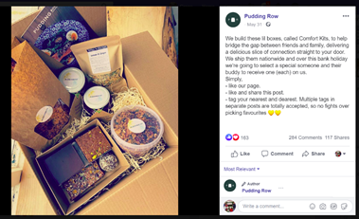
LEAN INNOVATION - EXAMPLES
Lean innovation
Pudding Row opened its doors in July 2015 to a warm reception and has become a flourishing business but when COVID19 hit Ireland in March 2020, the business like so many others was forced into lock down. After several weeks though the business bounced back and launched a thriving online shop and a special new product called the “Comfort Kit” which that has helped the business not only stay alive but thrive in unprecedented times.
What is the Comfort Kit?
“Comfort Kits special package to help bridge the gap between friends and family, delivering a delicious slice of connection straight to your door. Each kit includes: bagels x 8, a selection box, homemade raspberry jam, tomato and apple chutney, homemade granola and a delicious tea.”

Slide 23
LEAN INNOVATION - SUMMARY
Applying Lean Innovation in micro enterprises can:
Reduce operating costs (management and production costs) and increase economic efficiency. Innovation is to enhance enterprice content management, long-term and healthy development of an effective and sustaiable path.
Develop and embody the enterpreneurial spirit (management skills, ability and innovative collaboration capabilities).
Mobilize the creativity of the Staff. Employees need to see enterprise development vision and personal goal so that they play their own advantages to realize their own value. This will improve employee enthusiasm and creativity.
Help in implementation of the „homeopathic” development. Micro enterprises must adapt to the development of the market, to enhance market competitiveness and the endigenous power to innovate together with handling legal and environmental issues.
Lean innovation in micro enterprises is all about levelling the playing field.

