Slide 1
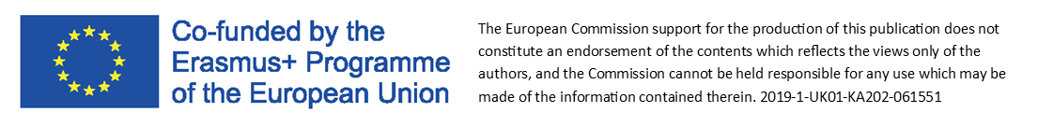
Module 2:
Lean Innvoation Model Canvas

Slide 2
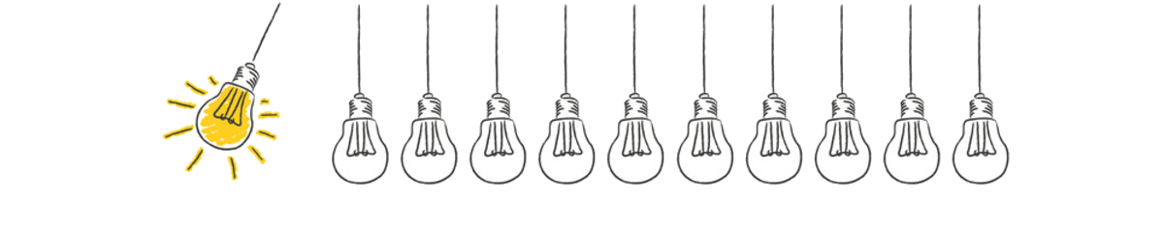
Source: A. Osterwalder, Y. Pigneur, Ch. Tucci, Clarifying Business Models: Origins, Present, and Future of the Concept.
If YOU:
are an enterprising person,
think about how to create value and build new business,
want to improve or transform…
The business model
is a description of the value that the enterprise offers.
The Lean Innovation Model Canvas
…meet

Slide 3

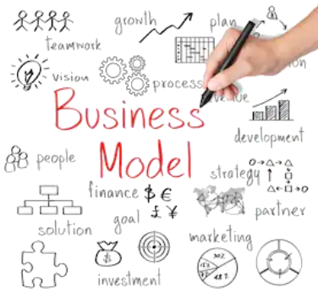
Reasons why the business model is important:
helps determine what the consumer receives from the company;
helps achieve business success;
helps test a new idea to see if it has a real chance of success;
helps to develop the company's mission and vision;
helps create a set of values that will help you manage your business;
helps create an image of potential customers;
helps to create a schedule for achieving goals and tasks;
helps create an offer of products and services;
helps to create marketing strategies.
Source: http://www.itee.radom.pl/images/kompendium.pdf

Slide 4


It is a tool enabling the development of potential business models on one A4 sheet.
Lean Canvas
-
What it is?
Business plans take too long to write…
That’s why sometimes it is better to create a Lean Canvas instead of writing
a business plan.
created by
Ash Maurya
All You need is
1 page of paper
☺
Business models created in this way are "slimmed" from redundant information.
Source: https://www.businessmodelcompetition.com

Slide 5


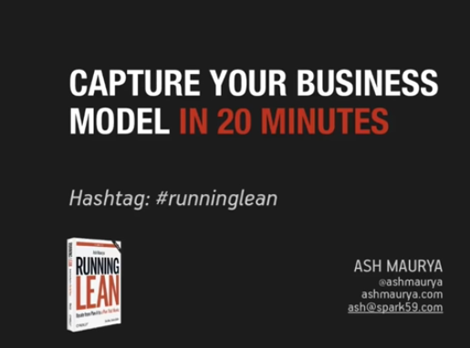
Draw it on a large sheet.
Make it visual.
Involve everyone.
Watch
This tool guided the entrepreneur as they navigated their way from ideation to building a successful startup.
This tool can solve the problem
and it takes under 20 minutes
(22mins)
Source: https://leadflowmethod.com/message/introduction-lean-canvas/

Slide 6
Business Model Canvas
Key partners | Key Activities | Unique value Proposition |  | CustomeR Relationships | Customer Segments
 | Key resources |  |  | Channels
Cost Structure |  |  | Revenue streams
Source: http://www.itee.radom.pl/images/kompendium.pdf/
Business model can be described through nine basic building blocks that show the logic of how company intends to make money.

Slide 7









Business Model Canvas vs Lean Canvas
PRODUCT
MARKET
Key partners | Key Activities | Unique value Proposition |  | CustomeR Relationships | Customer Segments
 | Key resources |  |  | Channels
Cost Structure |  |  | Revenue streams
Unfair
Advantage
Solution
Problem
Source: https://medium.com/@steve_mullen/an-introduction-to-lean-canvas-5c17c469d3e0
Key Metrics
Lean Innovation Model Canvas is a shared language for describing, visualizing, assesing and changing business models.

Slide 8
“A problem well stated is a problem half-solved.”
Charles Kettering
Indicate the most important problems or needs identified for a given customer segment.
It is worth supplementing with existing alternative solutions to these problems.
Problem
Most startups fail, not because they fail to build what they set out to build, but because they waste time, money, and effort building the wrong product.
Problem | Solution | Value Proposition |  | Unfair advantage | Customer Segments
 | Key metrics |  |  | Channels
Cost Structure |  |  | Revenue streams

Slide 9

Determining the right target group is crucial because customers are the source of revenue.
Indicate the customer segments whose problems we want to solve.
We are most interested in early adopters.
Customer segments
Segmentation allows you to highlight the most important features and needs of recipients and make better offer to them.
Customer groups represent separate segments if:
they require different types of relationships
they have substantially different profitabilities
they are willing to pay for different aspects of the offer
Problem | Solution | Value Proposition |  | Unfair advantage | Customer Segments
 | Key metrics |  |  | Channels
Cost Structure |  |  | Revenue streams
Source: A. Osterwalder, Y. Pigneur, Business Model Generation: A Handbook for Visionaries, Game Changers, and Challengers.

Slide 10
Indicate product features that will help solve the problems defined.
Solutions should be assigned to problems.
Once you understand the problem, you are then in the best position to define a possible solution.
This solution should be based on MVP.
Solution
MVP (Minimum Viable Product) - version of a new product which allows a team to collect the maximum amount of validated learning about customers with the least effort.
Source: https://www.agilealliance.org
Problem | Solution | Value Proposition |  | Unfair advantage | Customer Segments
 | Key metrics |  |  | Channels
Cost Structure |  |  | Revenue streams

Slide 11
Formulate a clear, attractive message, which shows why we are different and why it is worth buying our product.
In this message we should include a short sentence that serves as an advertising slogan.
Goal - show uniqueness and attract the attention of early adopters.
VALUE may be Quantitative
(e.g. price, speed of service)
or
Qualitative
(e.g. design, customer experience)
Unique
value proposition
New - based on a new or innovative element
Implementation - develop the same products in improved versions
Adaptation to the customer - modern consumers believe in individuality
Design - customer pays a higher price for a specific brand (design)
Brand / Status - people show loyalty to a brand due to its status in society
Price - the most common element on which the value proposition is based
Cost reduction - products have been created to increase customer satisfaction by reducing costs
Risk reduction - the lower the risk associated with the purchase of a product or service, the more value the customer derives from it
Accessibility - making the previously unavailable product available to the consumer segment
Convenience / usability - providing consumers with a product that increases their convenience and usability
Problem | Solution | Value Proposition |  | Unfair advantage | Customer Segments
 | Key metrics |  |  | Channels
Cost Structure |  |  | Revenue streams
Source: http://www.itee.radom.pl/images/kompendium.pdf

Slide 12


The next step is to isolate paths to reach people who will verify our product.
Functions of channels:
raising customer awareness about the company's products,
helping clients evaluate the company's value proposition,
enabling customers to purchase products,
providing value offers to customers,
providing customer service after purchase.
self
direct
(own PoS, partner PoS, wholesale)
higher margin
expensive to set up and maintain
Channels
in partnership
indirect
(sales department, internet)
the opportunity to expand the company's reach, benefits from the partner's strengths
lower profit margin
Problem | Solution | Value Proposition |  | Unfair advantage | Customer Segments
 | Key metrics |  |  | Channels
Cost Structure |  |  | Revenue streams
Source: A. Osterwalder, Y. Pigneur, Business Model Generation: A Handbook for Visionaries, Game Changers, and Challengers.

Slide 13

Let's specify how we want to earn on the product (charging fees, margin etc.)
Methods that allow you to assess the revenue stream:
Usage fee - usually charged by service providers to customers for using the service
Subscription fees - when the user requires long-term or permanent access to the company's products
Borrowing / renting / leasing - some organizations provide their clients with exclusive rights to their products for a limited time for a fixed fee
Licensing - usually used for products or ideas that fall under the intellectual property criterion
Brokerage fee - when a company acts as an intermediary to facilitate communication and transactions between two or more parties
Advertising - the fee is charged for promoting another organization, product
Sale of assets - refers to the transfer of ownership
Revenue streams
Problem | Solution | Value Proposition |  | Unfair advantage | Customer Segments
 | Key metrics |  |  | Channels
Cost Structure |  |  | Revenue streams
Source: A. Osterwalder, Y. Pigneur, Business Model Generation: A Handbook for Visionaries, Game Changers, and Challengers.

Slide 14

Specify the most important project costs.
The purpose of comparing revenues with costs is to estimate the point of profitability of the product.
focused on costs – cost reduction whenever it’s possible
Cost structure
focused on value – paying more attention to product quality
Types of costs:
Fixed costs - the main cost component of many companies, in particular service providers: media, accounting. Includes labour, office, marketing etc
Variable costs - costs associated with volume related production factors, e.g. raw materials, manufacturing labour
Problem | Solution | Value Proposition |  | Unfair advantage | Customer Segments
 | Key metrics |  |  | Channels
Cost Structure |  |  | Revenue streams

Slide 15

“A startup can only focus on one metric. So you have to decide what that is and ignore everything else.”
- Noah Kagan
Choose indicators that tell us if our customers are using the product in the right way.
Failure to identify the right key metric can be catastrophic for micro enterprises — it can lead to wasteful activities like running out of resources while chasing the wrong goal.
Key
metrics
Examples of indicators based on Dave McClure’s Pirate Metrics:
Acquisition
How do consumers find you?
Activation
Do customers get a good first impression?
Retention
Are customers returning?
Referral
Do your customers talk about you?
Revenue
How can you increase revenue?
Problem | Solution | Value Proposition |  | Unfair advantage | Customer Segments
 | Key metrics |  |  | Channels
Cost Structure |  |  | Revenue streams
Source: https://www.paldesk.com/aarrr-pirate-metrics/

Slide 16


“A true unfair advantage is something
that cannot be easily copied or bought.”
Jason Cohen
“Perfection is achieved, not when you have nothing left to add,
but nothing left to take away”.
Antoine de Saint-Exupery
We can also name it as competitive advantage or barriers to entry that is often found in a business plan.
This is something that cannot be easily copied or bought.
There is always a risk of new competitors emerging.
For this reason, we should constantly seek, find and build an unfair advantage.
Unfair advantage
Unique value proposition (Uvp) ≠ Unfair advantage (Ua)
Unique value proposition is to capture a customer’s attention.
Unfair advantage is to deter competitors.
Problem | Solution | Value Proposition |  | Unfair advantage | Customer Segments
 | Key metrics |  |  | Channels
Cost Structure |  |  | Revenue streams
Example:
Uvp: “Connect and share with the people in your life.”
Ua: Large network effects
Source: https://blog.leanstack.com

Slide 17
Advantages of the
Lean Innovation Model Canvas
Intuitive
Universal
Different
No MBA required
Used around the world
Customer-problem-solution focused
Simple
Practical
Actionable
The power of the Lean Canvas lies in it’s simplicity
Built by entrepreneurs for entrepreneurs,
not for consultants.
Get better business outcomes
Fast
Portable
Effective
It’s much easier to share this model with other people
Give opportunity to effectively document and communicate progress
You can create it in one afternoon
Source: https://leanstack.com/leancanvas

Slide 18



Sources:
Websites:
Videos:
Other sources:
https://blog.leanstack.com
https://www.businessmodelcompetition.com
https://medium.com/@steve_mullen/an-introduction-to-lean-canvas-5c17c469d3e0
https://www.agilealliance.org
https://www.paldesk.com/aarrr-pirate-metrics/
https://leanstack.com/leancanvas
http://www.itee.radom.pl/images/kompendium.pdf
https://railsware.com/blog/5-lean-canvas-examples/
https://www.businessmodelcompetition.com
https://www.youtube.com/watch?v=Csofgp9Bcyo
https://www.youtube.com/watch?v=HDW-xKIGKRg
https://www.youtube.com/watch?v=k6DHEv5vWFI
https://www.youtube.com/watch?v=tLFzhz78Ock
https://www.youtube.com/watch?v=8n20QGWiFYQ
https://www.youtube.com/watch?v=pvIN9STpzCQ
https://leadflowmethod.com/message/introduction-lean-canvas/
A. Osterwalder, Y. Pigneur, Ch. Tucci (2005), Clarifying Business Models: Origins, Present, and Future of the Concept, Communications of the Association for Information Systems,Vol. 16.
A. Osterwalder, Y. Pigneur (2010), Business Model Generation: A Handbook for Visionaries, Game Changers, and Challengers. John Wiley & Sons.

Slide 19

Create a Lean Innovation Model Canvas for your micro enterprise.
Rules:
The duration of the exercise is 20 minutes.
There is nothing wrong with some fields being left blank. Empty categories mean that they pose a risk to the success of the project.
Focus on the present.
Complete the Lean Canvas in the right order.
Task
1. Problem | 4. Solution | 3. Value Proposition |  | 9. Unfair advantage | 2. Customer Segments
 | 8. Key metrics |  |  | 5. Channels
7. Cost Structure |  |  | 6. Revenue streams

Slide 20

Let’s start thinking lean
and create
Lean Innovation
Model Canvas

