Slide 1

Module 3:
Concept Development

Slide 2

OVERVIEW
Module Overview
Concept development case study
Idea generation (ideate)
Accumulation of information – the checklist
Idea screening (filter)
Building the actual business case
Concept template
7 simple ways to improve concept development

Slide 3
1. Concept development case study

Slide 4
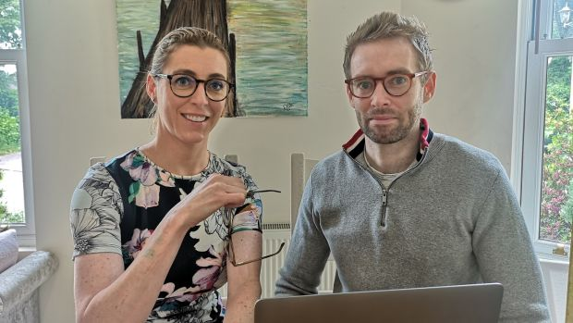
1. CASE STUDY OF CONCEPT DEVELOPMENT
1. Concept Development Case Study
Seamus Flynn and Dearbhaile Collins, Sapphire Eyewear, Cork
Website: https://www.sapphireeyewear.com/
Facebook: https://www.facebook.com/sapphire.eyewear/
Seamus is an optometrist.
Dearbhaile is a cancer doctor.

Slide 5

1. CASE STUDY OF CONCEPT DEVELOPMENT
How they came up with the idea
By observation of their own problem of visual discomfort after spending a lot of time
on computers. Dearbhaile spends a lot of time on computers researching cancer treatments.
Seamus had also noticed a huge increase in the number of complaints of digital eyestrain especially in the last 5 years or so due to the increasing amount of time we now spend looking at computers, tablets and smartphones. So they set out to make anti-blue light protective glasses more available, accessible and affordable.
They knew that all the extra screen time means more of us are exposed for longer to damaging blue light from devices, which causes eye strain and headaches.
So they came up with the idea of producing eyeglasses that protect the eyes from blue light.
They sourced lenses and high-quality frames and started putting pairs of glasses together in the garage.

Slide 6
2. Idea generation –
a systematic search to find out new ideas

Slide 7
2. IDEA GENERATION
What should you do?
You need to understand:
What are the market trends?
What do customers want?
Identify an important market and the company's goals for innovation in your market
Find the trends
Talk to people who lead that trend about their experience and intensity of needs
Consult customers, suppliers, and their customers and suppliers,
to find someone who knows even more about the area or the 'problem'
Hold a workshop with leading figures and your own employees
Start by working in smaller groups and then all together in order to develop a product concept that involves a number of possible products
http://qpc.adm.slu.se/SNPD_ver2/page_19.htm

Slide 8
How to know what customers want?
2. IDEA GENERATION
Sources of new ideas:
Internal sources
External sources

Slide 9
2. IDEA GENERATION
Internal sources
Employees
Engineering/
IT
Shelved ideas
Complaints systems
Customer service
Sales force

Slide 10
2. IDEA GENERATION
External sources
Customers
Lead-users (user solutions)
Patents/
inventions
Competitors
Suppliers
Acquisitions
Trade fairs & conventions
Published information
Trade magazines
Outside consultants
Universities
Government

Slide 11

2. IDEA GENERATION
Customer voice and pain points
– how to acquire them?
Questions
Complaints
Feedback
NEW PRODUCT IDEA
It is likely that your next big product idea may be found among your customers!
What could be the problem?
Customers often are not be aware of what they need if asked.
In order for you both to discover that idea, you need to do things together.
One way is to arrange with your customer to spend an agreed period of time at the workplace with them, when you think they are most likely to have ideas about their job. This is particularly appropriate when dealing with products that are used in a way that you and your company don't really understand or know how to improve.
A company supplying machinery for bakeries was looking for ways to improve its products. After two weeks on site with a baker they came up with variety of ideas for new products that they had never thought of before.
For fast-moving products, working in micro-enterprises, for example, a shop, bar or restaurant, can give you similar experiences to bring back to your own product development.
An example

Slide 12

Competitors
2. IDEA GENERATION
What you can do to find a product/service idea?
Prepare a SWOT analysis
of your main competitor…
Watch
Strengths
Weaknesses
to find out
SWOT
analysis
You Tube Link
what is the gap in competitor’s products/services that you might fill with your products/services.
(7mins)
Threats
Opportunities

Slide 13
Distributors and suppliers (collaborators)
2. IDEA GENERATION
…know the techniques to address these problems
…know customers’ problems…
are close to the market…
So ask them!

Slide 14
3. Accumulation of information
– the checklist

Slide 15
3. ACCUMULATION OF INFORMATION
The Ideation Stimulator Checklist – a practical example of a systematic approach to developing new ideas
It provides a list of considerations that are classified according to different aspects of the product:
Dimensionality | Larger, Smaller, Longer, Shorter, Thicker, Thinner, Deeper, Shallow, Stand Vertically, Place Horizontally, Make Slanted Or Parallel, Stratify, Invert (Reverse), Crosswise
Quantity | More, Less, Change Proportions, Fractionate, Join Something, Add Something To It, Combine With Something Else, Complete
Order | Arrangement, Precedence, Beginning, Assembly/Disassembly, Focus
Time | Faster, Slower, Longer, Shorter, Chronological, Perpetuated, Synchronized, Anticipated, Renewed, Recurrent, Alternated
Cause/effect | Stimulated, Energized, Strengthened, Louder, Softer, Altered, Destroyed, Influenced, Counteracted
Character | Stronger, Weaker, Altered, Converted, Substituted, Interchanged, Stabilized, Reversed, Resilient, Uniformity, Cheaper, More Expensive, Add Colour, Change Colour
form | Animated, Stilled, Speeded, Slowed, Directed, Deviated, Attracted, Repelled, Admitted, Barred, Lifted, Lowered, Rotated, Oscillated, Agitated
State/ condition | Hotter, Colder, Harden, Soften, Open Or Closed, Preformed, Disposable, Incorporated, Parted, Solidified, Liquefied, Vaporized, Pulverized, Abraded, Lubricated, Wetter, Drier, Insulated, Effervesced, Coagulated, Elasticized, Resistant, Lighter, Heavier
Adoption to new market | Men, Women, Children, Old, Handicapped, Foreign
Source: C. Merle Crawford, C. Anthony Di Benedetto, New Products Management, 11th Edition, McGraw-Hill Education, 2014

Slide 16
4. Idea screening
– analysing the collected data

Slide 17
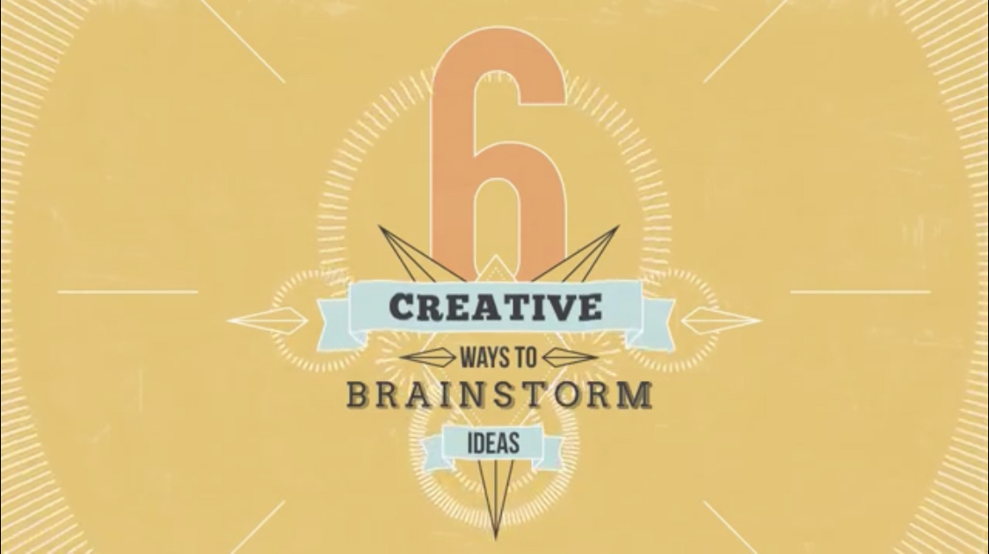
4. IDEA SCREENING
Designers, employees, thinkers
generate and discuss ideas by brainstorming or design thinking
Watch
“Design thinking” will be descibed in Module 4
You Tube Link
(3.5mins)
It might provide innovation or solutions!

Slide 18
4. IDEA SCREENING
How to find good ideas
and drop the poor ones?
What are the factors influencing the evaluation criteria?
What to do to make the idea succeed?
You need to answer the following questions:
What are company strengths and weaknesses that You might deal with?
Is the product useful to customers’ needs?
What are company objectives and resources (do You have enough people and skills)?
What is the affordability, advertising and distribution?
What is the expected return on investment?
What are current trends?

Slide 19
5. Building the actual business case

Slide 20
5. BUILDING THE ACTUALL BUSINESS CASE
After finding a good idea…
The Next requirement is…
…prepare a detailed description of the idea
(a more physical and visual presentation for a more reliable concept test)
What needs to be done?
This is the final stage prior to actual product development.
A detailed business analysis will clearly define the New Product Development project and to verify the attractiveness of the product to be developed.

Slide 21
5. BUILDING THE ACTUALL BUSINESS CASE
Make a competitive analysis to benchmark your product advantage, compared to what is (or is going to be) offered on the market
Make a detailed technical appraisal focusing on the “do-ability” of the project.
Customer needs and “wish lists” need to be translated into technically and economically feasible solutions.
Do an operations appraisal.
This is where you assess any manufacturing costs or the additional investment necessary.
Finally, a detailed financial analysis to get an overview of the financial figures involved.

Slide 22
6. Concept template

Slide 23
6. CONCEPT TEMPLATE
You can use the following simple concept template:
Core concept | Provide a statement with the core concept in one sentence
 | Use a preliminary product name (if available)
benefits | Describe the product benefits, based on sensory, convenience, health, process and other product attributes
 | Decide on “stripped” versus “embellished” formulations (for more information see: C. M. Crawford, C. A. Di benedetto (2008), new product management, mcgraw hill, new York)
Product information | Provide information about relevant extrinsic cues such as price, size, product-related information
Target users | Tell your respondent how you would describe him or her
 | Describe the person based on segmentation criteria
 | Ask if he or she feels the description is appropriate. (Do not forget to ask about personal information, before or after the test.)
Source: L. Peng, A. Finn, (2008), “Concept testing: the state of contemporary practice", Marketing Intelligence & Planning, Vol. 26 No. 6, pp. 649-674; C. M. Crawford, C. A. Di Benedetto (2008), New product management, McGraw Hill, New York.

Slide 24
7. Seven simple ways to improve concept development

Slide 25



7. Seven simple ways to improve concept development
“Size” the opportunity, not the market
Look at the entire market through the lens of your customer to determine the actual potential.
By accurately sizing the opportunity, you can set proper expectations of what can be achieved.

Slide 26

7. Seven simple ways to improve concept development
Kill a few new ideas
Choose only the best project to develop
Too many organizations carry all their new ideas through the development cycle when some should have been left behind
Carrying new ideas too far wastes resources and distracts the team’s efforts from focusing on the winners
Make sure you have comprehensive parameters against which to screen new product and service ideas
Establish the elements that an idea must have to stay on the list
If an idea does not meet your revenue requirements cut it from the list or figure out how to rework it so that it can make more money

Slide 27



7. Seven simple ways to improve concept development
Find the pain points of users
You need to find answers to these two most important questions:
What is the actual purpose of your new product or service?
What need does it solve?
For Example
What might they want after having fun in the snow?
Many businesses incorrectly develop benefit statements based on a new offering’s features instead of its actual benefits.
If you don’t thoroughly understand your target group’s pain points, you can easily undersell the very real benefits of your product or service.
This or that?

Slide 28

7. Seven simple ways to improve concept development
Price for customers
Pricing needs to be based on your customer’s cost threshold to ensure that price does not become a barrier to purchase for people who truly want the product.
For Example
What will she be able to buy?
This OR that?

Slide 29

7. Seven simple ways to improve concept development
Get customers involved early
You can reality-proof your concepts by including your customer in the product development cycle — especially if you do it well before you launch.

Slide 30


7. Seven simple ways to improve concept development
Dedicate a team to the job
(and empower them to do great work)
Responsibility for the success of a new product or service should not be spread among too many individuals
You should look to empower a lead person so that they have authority and resources

Slide 31
7. Seven simple ways to improve concept development
Consider life after launch
Prepare a detailed plan as to how this new product will be supported by the product development team.
You should also have extensive training and education available internally to staff.
The development team and sales/support teams should work in tandem (maybe even involve sales team earlier in the development process).
The initial question is:
How the new product or service will be supported and improved upon
throughout its lifecycle?

Slide 32

7. Seven simple ways to improve concept development
But you will learn about these steps from the next modules.
After the business analysis of chosen idea is done…
The next step is…
MINIMUM VIABLE PRODUCT ASSESSMENT, EXPERIMENTATION/TESTING
This helps companies to investigate customers reactions before introducing to the market.
And the final step is…
FIRST INTRODUCTION TO THE MARKET AND EVALUATION OF THE PRODUCT
What are the customer’s reactions in term of feedback.
Is the concept appealing or not? Does the innovation fulfill the customers needs?

Slide 33
SUMMARY
SUMMARY
Case study of concept development
Idea generation (ideate)
Accumulation of information – the checklist
Idea screening (filter)
Building the actual business case
Concept template
7 simple ways to improve concept development

