Slide 1

Module 4
Design Thinking

Slide 2

The solution for businesses that prompts them to intensify their innovative activities and permanent development, is the concept of creating innovation based on the design work method...
Source: E. Wise, Understanding User-Driven Innovation.
In strategic terms, the use of the concept of design thinking assumes the development of new working methods.
…it’s Design Thinking

Slide 3
Design thinking is a process that is human-oriented, based on observation, cooperation, fast learning, visualization of ideas, rapid prototyping and the use of business analysis.
creative
According to Design Thinking,
3 basic forces create business development:
Deep understanding of the user
Concept visualization
Strategic business design
Solving problems in a way that is:
practical
interactive
Source: https://www.parp.gov.pl/files/74/81/545/20508.pdf

Slide 4
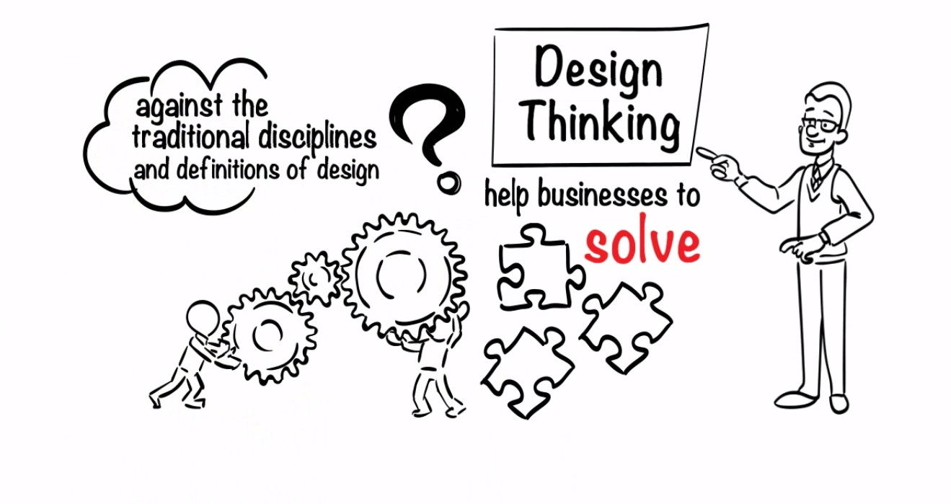
The use of design thinking creates:
WATCH
deep understanding of customer needs
higher quality products and services at a lower cost
changes in the organization's culture supportive to innovation
new development perspectives
Increased efficiency of operations and production
better communication with the client
permanent improvement of the user's relationship with the brand
stand out from the competition
Consistency between the brand and the offer to customers
(6.0 mins)
Design thinking helps businesses to solve complex problems
Source: https://www.youtube.com/watch?v=GPXeeyL4tEA
Source: M. Lubińska, A. Więcka, Jak wykorzystać design w biznesie.

Slide 5
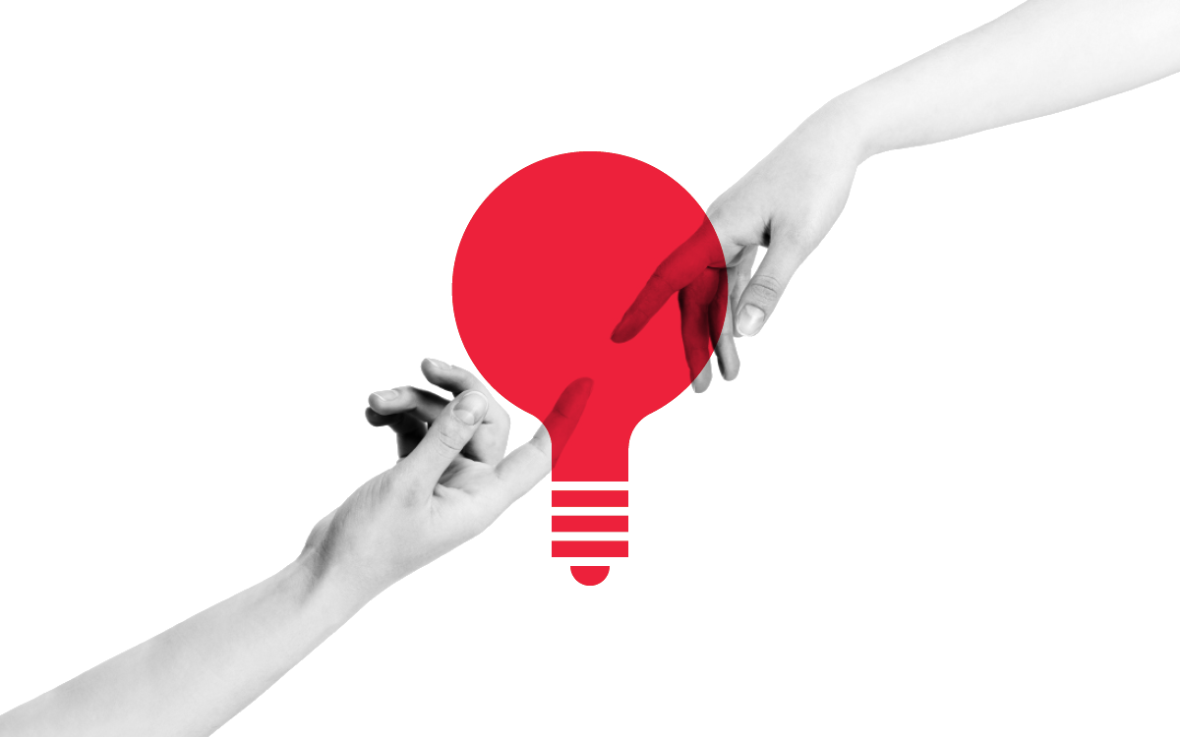
The most important question to ask first in design thinking is: “What value can I create for my users?”
This creative and experimental approach offers a better understanding of how to create things that are not only usable, but above all, useful.
The process of Design Thinking is particularly useful because it generates a unique and specific outcome:
knowledge
Source: https://www.toptal.com/project-managers/digital/a-design-thinking-case-study

Slide 6


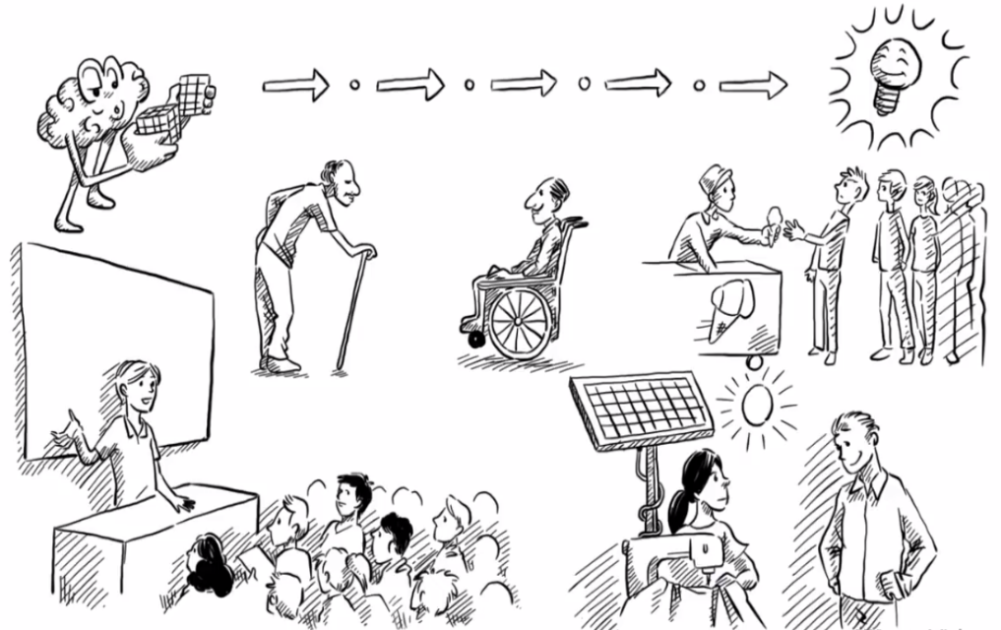




Design thinking process
WATCH – The 5 step design thinking process
1. Empathise
2. Define
3. Ideate
4. Prototype
5. Test
Source: https://www.youtube.com/watch?v=_r0VX-aU_T8
The design thinking process should be preceded by the development of the appropriate team.
4.0 mins)

Slide 7
Observing customer behavior in their natural environment
Goals:
Ensuring a common understanding of the challenge
Developing specialist knowledge about the project
Expanding knowledge about the user and their problems
Obtaining knowledge about the background of the problem, the place of use of the product, and the operating environment
We shouldn’t draw conclusions at this stage
Examples of tools used at this stage:
brainstorming about the design challenge
shadowing
discussing key project conditions
bodystorming
testing existing solutions
role playing
1. Empathise
target group observation
card sorting
conducting interviews with potential clients
inspiration cards
listening to the client's voice
empathy mapping
safari design
Rose-Bud-Thorn
Source: https://play.google.com/books/reader?id=2yyDDwAAQBAJ&hl=pl&pg=GBS.PT10
https://contentsolutions.pl/5-krokow-do-tworzenia-lepszego-contentu-design-thinking/

Slide 8



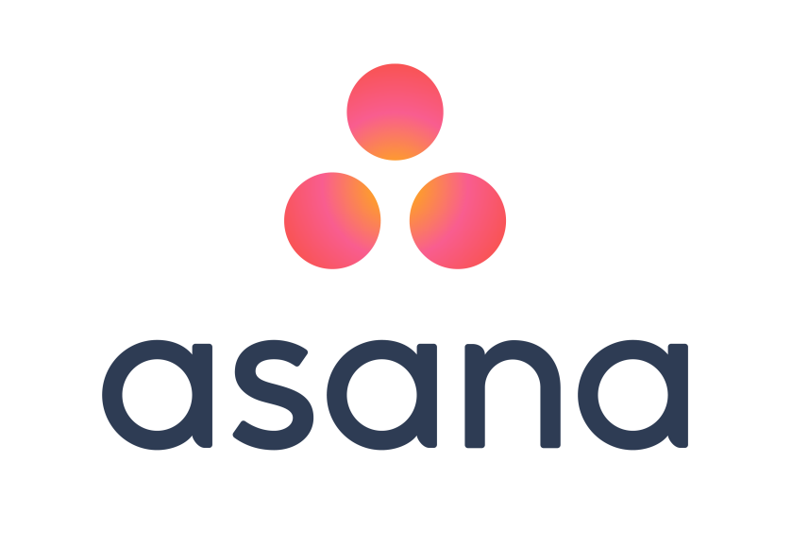



Specifying the assumptions and problems that we have to face
Goal – a summary of the potential user and their point of view
We need to identify the problems
and needs of the target group
Examples of tools used at this stage:
empathy maps
Story Telling
customer path mapping
lean canvas
apps: e.g. Trello, Asana, Evernote, OneNote
2. Define
Source: https://play.google.com/books/reader?id=2yyDDwAAQBAJ&hl=pl&pg=GBS.PT10
https://contentsolutions.pl/5-krokow-do-tworzenia-lepszego-contentu-design-thinking/

Slide 9

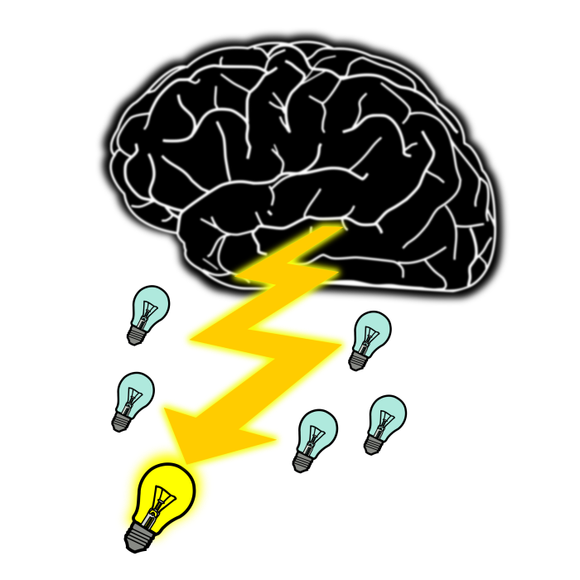
Goal – generating and collecting as many ideas as possible in order to obtain the optimal solution
This phase should limit criticism
Quantity is what counts, not quality
There are no silly or wrong ideas!
“The only stupid idea is the one never expressed”
Creating a single idea is not a success
Creating 50 ideas, analyzing them and choosing the best one is a success
The key is forming real concepts and solutions, not just abstract definitions.
Examples of tools used at this stage:
brainstorming,
braindumping,
sketching,
brainwriting,
brainwalking,
6 thinking hats method,
SWOT method,
PEST method.
3. Ideate
Source: https://play.google.com/books/reader?id=2yyDDwAAQBAJ&hl=pl&pg=GBS.PT10
https://contentsolutions.pl/5-krokow-do-tworzenia-lepszego-contentu-design-thinking/

Slide 10

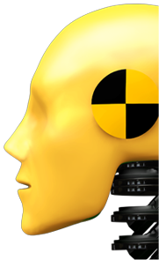
Checking solutions in practice
Time to choose the best ideas!
Narrow the created solutions to a maximum of several variants
Goal – creating at least one prototype
This phase is used to build simple prototypes as visual objects to demonstrate the effect of innovation
Don’t overcomplicate
Create a Minimum Viable Product as quickly as possible
4. Prototype
Source: https://play.google.com/books/reader?id=2yyDDwAAQBAJ&hl=pl&pg=GBS.PT10
https://contentsolutions.pl/5-krokow-do-tworzenia-lepszego-contentu-design-thinking/

Slide 11



Goal – Getting feedback from users about the prototype to make decisions about the next steps
The opportunity to test prototypes in real conditions
Collecting opinions through interviews
We must check whether the proposed solutions make sense and whether they meet the needs of our target group
The design thinking process is an iterative process. To adapt the prototype properly to the needs of its future users and really refine it, the last three phases should be repeated.
5. Test
Source: https://play.google.com/books/reader?id=2yyDDwAAQBAJ&hl=pl&pg=GBS.PT10
https://contentsolutions.pl/5-krokow-do-tworzenia-lepszego-contentu-design-thinking/

Slide 12

Rules of design thinking
1. The Human Rule: All Design Activity Is Ultimately Social in Nature
Implementing solutions should strive to meet human needs
2. The Ambiguity Rule: Design Thinkers Must Preserve Ambiguity
Moving away from restrictions and creating conditions for experimenting on the border of knowledge and imagination. Look for solutions that seem to be inappropriate
3. The Re-design Rule: All Design Is Re-design
Designing future technical and social conditions, based on historical solutions, in order to best analyze and solve the problem
4. The Tangibility Rule: Making Ideas Tangible Always Facilitates Communication
Making ideas reality by visualizing and prototyping improves communication among project team members
Source: H. Plattner,C. Meinel, L. Leifer, Design Thinking: Understand - Improve - Apply

Slide 13


Advantages and disadvantages
of design thinking
Advantages | Disadvantages
Frequent contacts with clients Extremely high customer focus Eliminating incorrect assumptions by monitoring the process Implementation of the basic functions Savings thanks to frequent user reviews Cost saving due to the omission of some components | User dependency Difficulty estimating trial time Communication with the user is difficult Physical and cultural distance to the user User needs may be unidentified High user impact, which may result in solutions that do not correspond to the competencies of the company
Source: U. Schleinkofer, T. Herrmann, I. Maier, T. Bauernhansl, D. Roth, D. Spath, Development and Evaluation of a Design Thinking Process Adapted to Frugal Production Systems for Emerging Markets

Slide 14
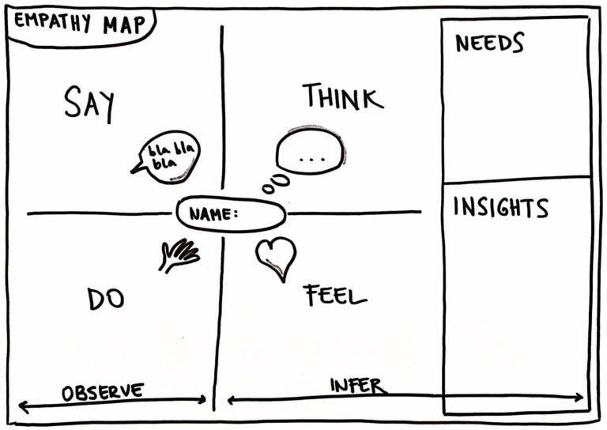
To visualise your users’ needs and wants across dimensions you can use Empathy Map Template Training
What is that?
It’s a collaborative approach to gain deeper insight into your customers or end users through learning what they:
SAY – What key messages is your user saying? How are they talking about your product/service?
THINK – What thoughts or beliefs might influence user's behavior?
FEEL – What nonverbal cues have your user given that indicates emotion?
DO – What actions and behaviour have you observed?
It’s based on your interviews, observations and other sources of gaining empathy.
You can do this map digitally or use paper with physical sticky-notes
Source: https://www.innovationtraining.org/empathy-map-template-training/

Slide 15
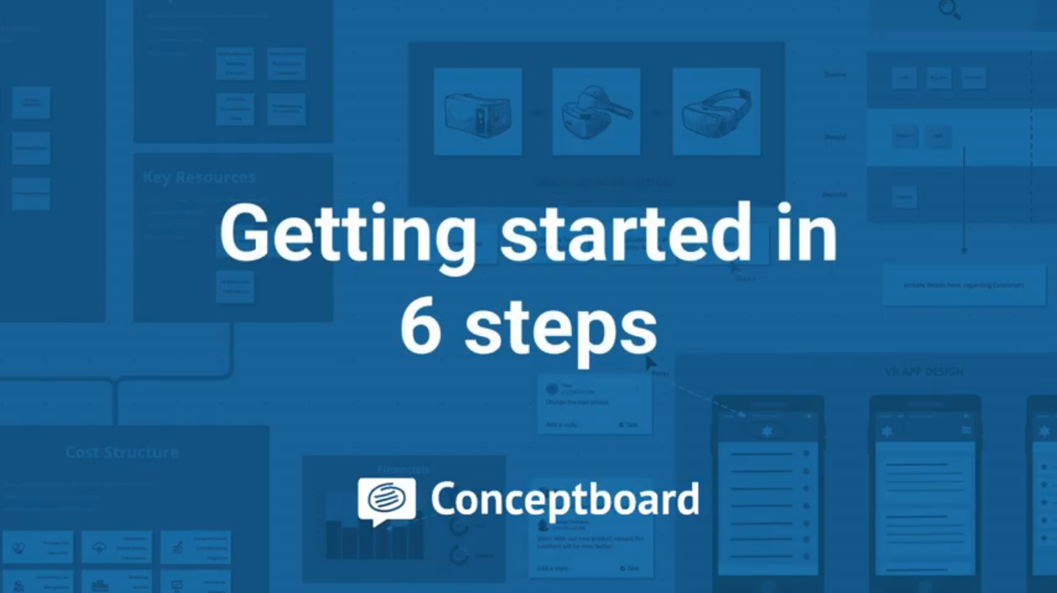
Do you want to use collaborative, digital workspace tool in the cloud?
WATCH
Meet Conceptboard
This is a centralized hub for all your content and ideas that can manage all your visual projects across one shared workspace
It keep teams organised so projects keep moving forward
This workspace enable teams to add ideas, files, notes, and real-time feedback
It can increase the productivity of remote teams
It's a useful tool to collaborate virtually & supercharge your teams’ collaboration
Source: https://www.youtube.com/watch?v=2iYae8zCMAI
(2.5 mins)
Source: https://conceptboard.com/

Slide 16

Design thinking in practice
A team of postgraduate students at Stanford were tasked with developing a new type of incubator for developing countries. Their direct contact with mothers in remote village settings who were unable to reach hospitals, helped them to reframe their challenge to a warming device rather than a new kind of incubator.
The end result was The Embrace Warmer, which has the potential to save thousands of lives.
The Embrace Warmer is capable of going where no incubator could go before, due to its portability and dramatically reduced production costs. This is an ultra-portable incubator which can be wrapped around an infant and be used while the infant is held in the mother’s arm.
Instead of needing to deposit their babies into far-flung hospitals, mothers in remote villages can use a portable warmer that serves the same need instead.
Had the team only thought of designing incubators, they may have developed a semi-portable lower cost incubator, which would still not have made it into remote villages.
However, with the help of empathy - i.e., understanding the problems mothers in remote villages face - the design team designed a human-centred solution that proved to be optimal for mothers in developing countries.
Source:https://www.interaction-design.org/literature/article/design-thinking-getting-started-with-empathy

Slide 17

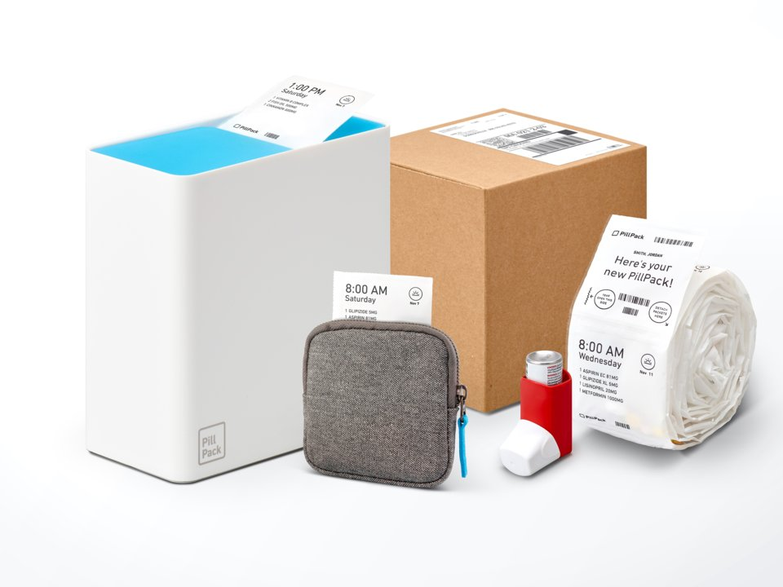
Design thinking in practice
Design thinking is a part of Airbnb’s success.
In particular, they built a culture of experimentation.
It was only when they gave themselves permission to experiment with non-scalable changes to the business that they climbed out of what they called the ‘trough of sorrow’.
Source: https://firstround.com/review/How-design-thinking-transformed-Airbnb-from-failing-startup-to-billion-dollar-business/
PillPack started as a startup-in-residence at IDEO Cambridge. Working with designers and using a human-centered approach, PillPack refined their brand vision, strategy, and identity.
PillPack was called one of the best inventions of 2014 by Time Magazine and Amazon bought PillPack for $1 Billion in 2018.
Their design thinking approach was successful.
Source: https://www.ideo.com/case-study/this-startup-revolutionized-an-industry-through-design

Slide 18
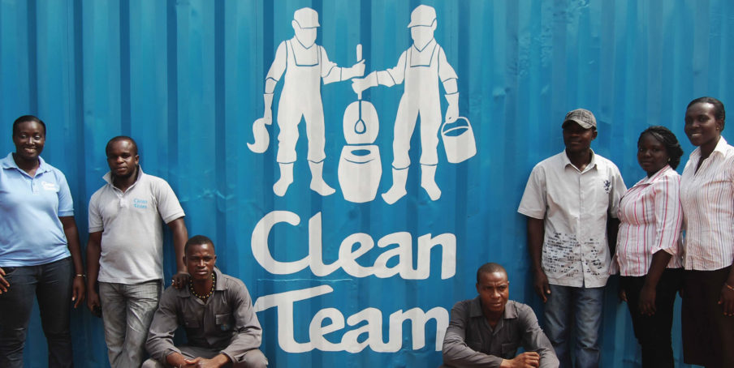
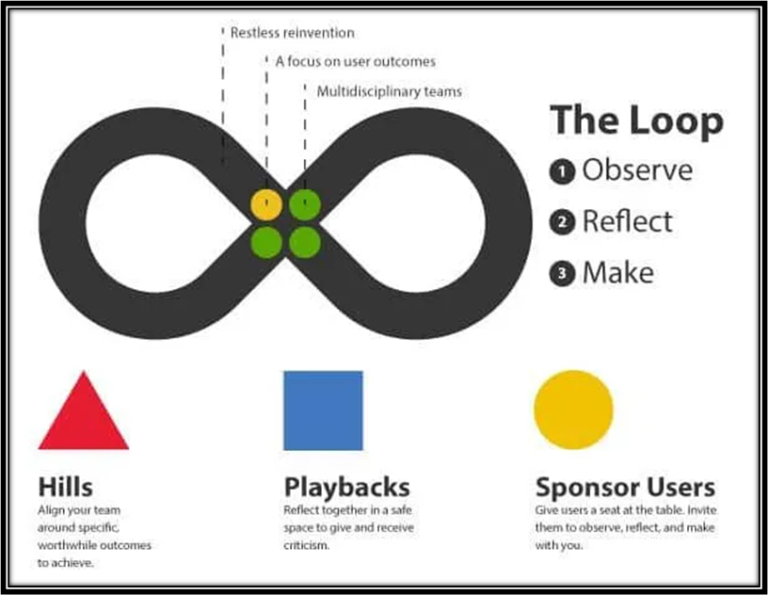
Design thinking in practice
Design thinking was applied in Clean Team to provide in-home toilets for Ghana’s urban poor.
For the millions of Ghanaians without in-home toilets, there are few good options when it comes to our body’s most basic functions.
Working with Unilever, and Water and Sanitation for the Urban Poor (WSUP), IDEO.org used design thinking to develop Clean Team, a comprehensive sanitation system that delivers and maintains toilets in the homes of subscribers.
Clean Team now serves 5,000 people in Kumasi, Ghana, making lives cleaner, healthier, and more dignified.
Source: https://www.designkit.org/case-studies/1
IBM is an example of a corporate giant who has deeply invested in design thinking and building a large internal design team.
They’ve seen the work pay off with a 301% (!)
They’ve made their enterprise design thinking assets available to everyone through this open toolkit.
Source: https://voltagecontrol.com/blog/8-great-design-thinking-examples/

Slide 19

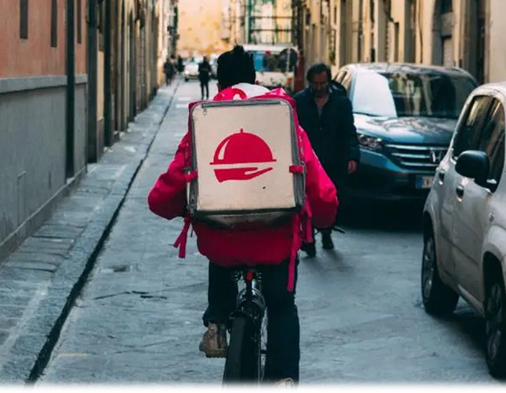
Design thinking in practice
Design thinking has found its way into the world of medicine and is seen by many as fundamental to the future of wellness.
Stanford Hospital used design thinking to explore ways to improve the patient experience in the emergency room.
Stanford administrators have been using design thinking to envision other new experiences for the hospital: “SHC staff used design thinking to complete a plan to redesign two nursing units in the current hospital to serve only patients with cancer.”
Source: https://med.stanford.edu/news/all-news/2016/06/design-thinking-as-a-way-to-improve-patient-experience.html
Uber Eats is an American online food ordering and delivery platform launched by Uber in 2014.
For Uber Eats, the most important phase in the design thinking process is empathy: “To understand all our different markets and how our products fit into the physical conditions of each city, we constantly immerse ourselves in the places where our customers live, work, and eat.
Sitting in our offices in San Francisco or New York, we can’t truly understand the experiences of a person on the streets of Bangkok or London.”
Source: https://medium.com/uber-design/how-we-design-on-the-ubereats-team-ff7c41fffb76

Slide 20


Design thinking in practice
Design thinking was used also by the Golden Gate Regional Center (GGRC), an organisation that provides services and financial support to people with developmental disabilities in the San Francisco Bay Area.
GGRC worked with design students from Stanford to rethink their lengthy assessment process, which often took months.
One outcome of the project was a culture change inside GGRC toward design thinking: “GGRC is now brainstorming improvement ideas and figuring out ways to prototype them on a regular basis.”
Source: https://hbr.org/2016/01/better-service-faster-a-design-thinking-case-study
Bank of America partnered with design consultancy IDEO in 2004 to understand how to get more people to open bank accounts.
They ultimately came up with the Keep the Change program.
This highly successful banking initiative came out of the design thinking research the IDEO team did where they found savers were intentionally rounding up when writing cheques.
Source: https://www.invisionapp.com/inside-design/applied-design-thinking/

Slide 21

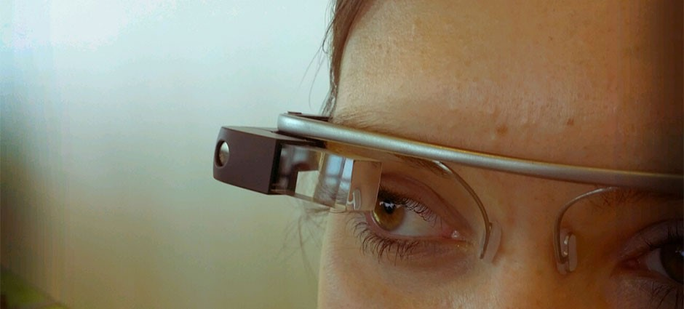
Designing without empathy
Google launched its first wearable product, the Google Glass, with much fanfare in 2013. The head-mounted wearable computer, while being technologically impressive, failed to perform well, and a lot of that comes down to a lack of empathy towards the users.
Although the Glass allows users to take photos, send messages and view other information such as weather and transport directions, it does not actually fulfil the real needs of users. In other words, although the Glass performs many things, these are not things you need or want to get done.
Lastly, the Glass featured a nondescript camera which resulted in privacy concerns for those people around the Glass user, since there was no way of knowing whether or not they were being filmed. All of these problems can be traced back to Google’s lack of empathy when they designed the Glass.
Source: https://www.interaction-design.org/literature/article/design-thinking-getting-started-with-empathy

Slide 22



Sources:
Websites:
Videos:
Other sources:
https://www.parp.gov.pl/files/74/81/545/20508.pdf
https://www.toptal.com/project-managers/digital/a-design-thinking-case-study
https://play.google.com/books/reader?id=2yyDDwAAQBAJ&hl=pl&pg=GBS.PT10
https://contentsolutions.pl/5-krokow-do-tworzenia-lepszego-contentu-design-thinking/
https://firstround.com/review/How-design-thinking-transformed-Airbnb-from-failing-startup-to-billion-dollar-business/
https://www.ideo.com/case-study/this-startup-revolutionized-an-industry-through-design
https://www.designkit.org/case-studies/1
https://voltagecontrol.com/blog/8-great-design-thinking-examples/
https://med.stanford.edu/news/all-news/2016/06/design-thinking-as-a-way-to-improve-patient-experience.html
https://medium.com/uber-design/how-we-design-on-the-ubereats-team-ff7c41fffb76
https://hbr.org/2016/01/better-service-faster-a-design-thinking-case-study
https://www.invisionapp.com/inside-design/applied-design-thinking/
https://dtdlafirm.pl/co-sie-stanie-gdy-wstaniemy-od-biurka-i-poznamy-wlasnego-klienta-czyli-empatia-w-design-thinking/
https://www.interaction-design.org/literature/article/design-thinking-getting-started-with-empathy
https://www.innovationtraining.org/empathy-map-template-training/
https://conceptboard.com/
https://www.youtube.com/watch?v=GPXeeyL4tEA
https://www.youtube.com/watch?v=_r0VX-aU_T8
https://www.youtube.com/watch?v=vQytKCT563I
https://www.youtube.com/watch?v=2iYae8zCMAI
M. Lubińska, A. Więcka (2015), Jak wykorzystać design w biznesie, PARP, Warszawa
H. Plattner, C. Meinel, L. Leifer (2011), Design Thinking: Understand - Improve - Apply, Heidelberg
U. Schleinkofer, T. Herrmann, I. Maier, T. Bauernhansl, D. Roth, D. Spath (2019), Development and Evaluation of a Design Thinking Process Adapted to Frugal Production Systems for Emerging Markets, Procedia Manufacturing 39

Slide 23

Task
Design a recruitment process for
a micro enterprise in the IT industry
Use design thinking method:
Empathy - try to understand the user's needs and problems.
Defining the problem - go beyond the standard schemes and frameworks within which we operate to expand the field of view.
Ideation - generate as many solutions for the problem as possible.
Prototyping - suggest a preliminary model to quickly gather feedback on it.
Testing - test the selected solution in the user’s (other people of group) environment.
The duration of the exercise (in groups) is 30 minutes.

Slide 24

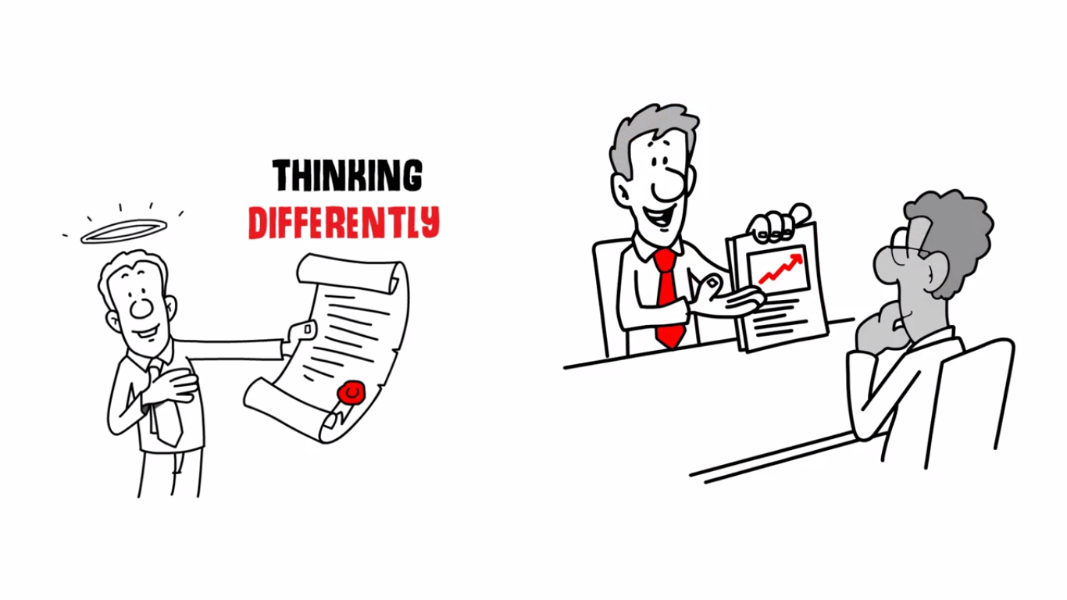
To sum up…watch
Don’t be affraid to think differently.
Put yourself in your customer shoes.
Source: https://www.youtube.com/watch?v=vQytKCT563I
(2.0 mins)

