Slide 1
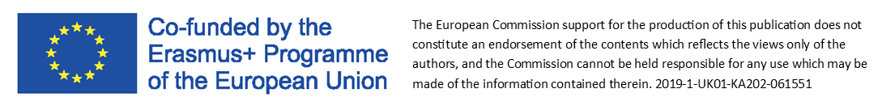
Module 5:
Minimum Viable Product (MVP)
and other techniques for testing and experimentation

Slide 2
MINIMUM VIABLE PRODUCT
HOW TO CHECK A BUSINESS IDEA?
The answer is
Minimum viable product (MVP)
The Lean method focuses on swiftly turning new ideas for products or services into iterative experiments. Lean practitioners build simple prototypes called “minimum viable products” (MVPs), move quickly to get feedback on these MVPs from customers, and then develop iterations of their MVPs on the basis of that feedback.
Source: https://ssir.org/articles/entry/the_promise_of_lean_experimentation
AND HOW TO DO IT?
Just a few simple steps to follow…..

Slide 3
Step 1 - create a product with minimal functionality
MINIMUM VIABLE PRODUCT
This is to obtain specific, real data from people interested in the product, for example, hints coming from the current buyers:
what else can you add to the product?
what items should you eliminate from this product, What is superfluous ?
how else can you solve certain issues related to the product?

Slide 4
Step 2 – measure all the data
MINIMUM VIABLE PRODUCT
What to do after creating a prototype?
Measure all the data that may interest you and be useful to improve the product and the offer itself
For example:
how many people visited the website?
how many people bought the product?
how many people filled in the form?
You now have specific data and specific numbers that you can work on later

Slide 5
Step 3 - you learn and improve
MINIMUM VIABLE PRODUCT
You improve, optimise, and work on various indicators to make the product better
Remember – sometimes just changing the headline can increase the effectiveness of the offer by up to 200%!

Slide 6
OK. But what for?
Why create such a product with only minimal functionality?
MINIMUM VIABLE PRODUCT
The advantage of the Minimum Viable Product strategy is that you receive an answer quickly to the question of whether it makes sense to create a given product, whether buyers will try to find it, or anyone will be interested in buying it.
The question is NOT "Can this product be built?”
Instead, the question should be: "Should this product be built?"

Slide 7
Practical application of MVP
MINIMUM VIABLE PRODUCT
Create Your MVP with Your Facebook account or blogspot!
For example - you would like to start blogging.
You don't have to immediately buy your own domain, server, install WordPress yourself, or employ a web designer.
Do you have a Facebook account? You can start blogging on a blogspot or just start a fanpage - it's very easy!
Remember!
MVPs are meant to be created BEFORE you ever spend any time, money, and resources building a saleable product or service.

Slide 8
MINIMUM VIABLE PRODUCT
How to create an MVP with minimal resources
Create an ad on Facebook or via AdWords.
The advertisement must refer directly to the offer.
Make a description of the product: its looks, functionality, characteristics, advantages, price etc.
People who will be interested in buying the product, will have to click “Buy”, enter their name, e-mail address, telephone number.
Next step which is completed by a customer is to click “Finalise”.
At this point, information is given that the product is currently unavailable/out of stock but the customer will be notified when it is back in stock OR “due to technical problems we are unable to finalise the order, we will inform You when we fix the problem”.
And because of that, You will know how many people want to buy Your product.
So even though the product may not physically exist yet, you have to check whether it is needed at all on the market

Slide 9
MVP
case study

Slide 10
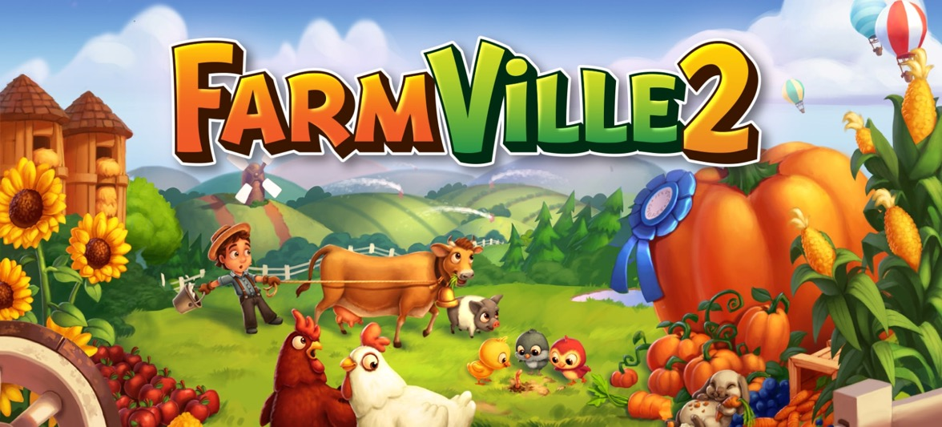
Create Your MVP with Your Facebook account or blogspot!
Some examples:
MVP CASE STUDY
Zynga (https://www.zynga.com), - one of the largest computer games producers. They created Farmville and Cityville - games that you probably know from Facebook.
How did they do it?
When they want to start a new production, then first a page is created about it with a very detailed description: what it will be, how it will work, what the boards will be etc.
Then collect e-mails of people interested in exchange for the promise that these people will be able to test the game first, for free!

Slide 11
MVP CASE STUDY
Another example is ZAPPOS
(https://www.zappos.com)
This is how the founder - Nick Swinmurn - did it
Did he buy 1000’s of pairs of shoes to sell? …….NO!
Then, how did he do it?
He just took pictures of the shoes in some stationary stores, threw them on the Internet, and then, put them up for sale. When someone chose a given pair of shoes and bought it from him in an online store, it was only then that he went to particular stationary store, bought these shoes and sent them to the customer! By doing this - he checked the business model itself.
Did he do anything else?
He noticed that some people carried out returns (due to mismatching of shoes to the foot), so he organized the whole system related to this:
While sending the pair of shoes (for example size 37), he supplied the courier (he signed a contract with UPS) with additional pairs of shoes: size 36 and 38. Three pairs came to the client, and the client was able to try on all 3 pairs. The client was able to decide on the size that suited best. The courier collected the other pairs and returned these to Zappos.
Watch “3 Awesome Minimum Viable Products (MVPs)”
You Tube Link

Slide 12
Other techniques:
The repetition cycle

Slide 13
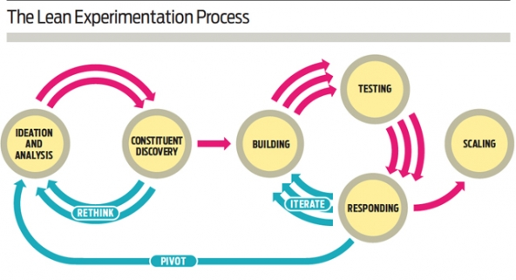
The lean experimentation process – the repetition cycle
THE REPETITION CYCLE
Source: https://ssir.org/articles/entry/the_promise_of_lean_experimentation

Slide 14


THE REPETITION CYCLE
Ideation and analysis
With Your generated ideas (value hypotheses) for programs and solutions that you think might solve people’s problems or help them achieve their aspirations;
- analyse similar programs and solutions that already exist
- figure out how your approach might improve on those offerings
(In the business world, this process is called “competitive differentiation”)
2. Constituent discovery
Get out of your office and listen to the people you hope to serve.
Through surveys and one-on-one conversations, find out what your customers truly need and want.
Put your “value hypotheses” in front of your customers and observe how they respond to those ideas.
(In the business world, this process is called “customer discovery”)

Slide 15


THE REPETITION CYCLE
3. Building
Determine one or two “riskiest hypotheses” that apply to your idea.
A risky hypothesis is an assumption that is critical to the success of your idea - an assumption that may, however, prove to be invalid.
In the lean innovation process, you should focus your attention on the riskiest hypotheses.
To test these hypotheses, develop an MVP (that is, a basic prototype of your idea). Also create a rough financial model for your idea that covers cost estimates and potential revenue sources.
4. Testing
Design a plan to validate (or invalidate) your riskiest hypotheses.
Then roll out your MVP to a group of customers and collect data on how they react to it.
But remember - avoid focusing on vanity metrics that might give you feel-good results but don’t actually help you validate or invalidate an idea.

Slide 16

THE REPETITION CYCLE
5. Responding to data
Analyse the results of your test.
Did your MVP appeal to fewer people than you had hoped it would?
Did it encounter unforeseen logistical challenges?
Did you charge a price for it that ended up being too high?
If your data shows that you have a flop on your hands, hit the reset button and begin the experimentation process again before investing more resources in your idea.
In the lean startup field, that’s called a “pivot”
If your data shows promise, use feedback from the test to build a better iteration of your idea.
Then test that version of the idea and continue iterating and testing the idea until you have verified that it will deliver its intended value.
In the lean startup model this process is the
“build – measure - learn” repetition cycle
LEARN
BUILD
MEASURE
6. Scaling up
Once you have an idea that works, use the data that you have gathered during the constituent discovery and testing phases to get buy-in (from your board, your staff, and your funders) for implementing the idea more widely.
As you scale up, continue to run experiments on ways to increase efficiency and to create additional value for your constituents.

Slide 17
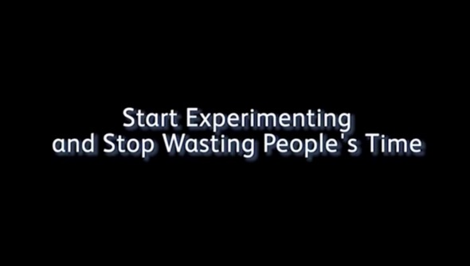

Testing and experimentation techniques
Watch: “Start Experimenting, and Stop Wasting People's Time”
Watch: “Test Before you Build”
You Tube Link
You Tube Link
(2.5 mins)
(3.5 mins)

Slide 18
How customers behave when you are there and when you aren’t
TESTING AND EXPERIMENTATION TECHNIQUES
Types of observation you might use during testing and experimentation processes
Direct observation
Indirect observation
Your presence around customers will give you an opportunity to ask questions and dig deeper into behaviors during the experiment.
It’s your chance to directly learn and improve your idea.
But remember - your presence might lead customers to act differently than how they would if you weren’t observing them.
You are more likely to get reliable data that is close to how customers would act in reality (e.g. how long they actually stay on a website).
Although It reduces your opportunity to learn about other things, staying away enables you to generate stronger evidence to a specific hypothesis.
Source: https://www.strategyzer.com/blog/posts/2015/4/30/ways-to-test-your-value-proposition-and-business-model

Slide 19
TESTING AND EXPERIMENTATION TECHNIQUES
Direct and Indirect experimentation and testing techniques
Direct contact with customers
Learn why and how to improve
Indirect observation of customers
Learn how many and how much
What customers do?
Observe their behaviour
A
N
T
H
R
O
P
O
L
O
G
I
S
T
D
E
T
E
C
T
I
V
E
LAB STUDIES
Learning prototype/MVP
Life-size prototypes
Wizard of Oz
SALES ACTIONS
Mock sales
Pre sales
Crowdfunding
TRACKING ACTIONS
Ad and link tracking
Landing page
Split testing
PARTICIPATORY DESIGN AND EVALUATION
Illustrations, storyboards and scenarios
Speedboat
Product box
What customers say?
Observe their attitudes
Field studies
Data analysis

Slide 20
Testing and experimentation techniques
TESTING AND EXPERIMENTATION TECHNIQUES
Life-size prototypes
Are there any products out there which already provide a solution to the customer’s problem?
What would the benefits be of your solution as opposed to the competitors?
2. Wizard of Oz
To run a "Wizard of Oz" MVP, set up a front stage that mimics a real, working value proposition.
On the back-end you will manually carry out the tasks of what would normally be a more automated process for delivering your value proposition.
3. Illustrations, storyboards and scenarios
https://www.strategyzer.com/blog/posts/2015/5/7/dont-build-when-you-build-measure-learn?utm_campaign=buffer&utm_content=buffer64700&utm_medium=social&utm_source=twitter.com

Slide 21
Testing and experimentation techniques
TESTING AND EXPERIMENTATION TECHNIQUES
Speedboat/Agile boat
The exercise takes the metaphor of a boat and gets players to think about what will cause them problems, or else help them move forward with a project.
The speed boat is much more than just a game; it will enable collective intelligence to be brought into play thanks to the following visuals: the boat, the Island, the wind, the anchors, the reef.
Once established, all of these elements enable four main themes to emerge, recalling the SWOT matrix: Strengths, Weaknesses, Opportunities and Threats.
5. Product box
A very effective MVP for physical products is to design a prototype of the product packaging for your imagined value proposition.
Get it into the hands of customers to see how they interact with it and respond to various aspects of the value proposition.
https://klaxoon.com/blog/speed-boat-an-agile-method-to-discover

Slide 22
Testing and experimentation techniques
TESTING AND EXPERIMENTATION TECHNIQUES
Mock sales - a mock sales presentation is a common exercise during which you make a presentation of a product/solution.
Preselling:
Create video “drop box like”
Fake sales page on social media e.g. Facebook, to find out if the customer is willing to pay. This should include a call to action with link to data/numbers for instance in Google Analytics.
Get payment before product is ready by giving the customers a VIP price with the clear stated message Help us to make the product awesome
Mocked up brochure which describes the core user journey and the value proposition
Crowdfunding: running a successful campaign means people are willing to buy your product.
Ad and link tracking- Ad tracking has made it possible for marketers to more accurately measure, test, and revise ads based on how users interact with their online campaigns.

Slide 23
Testing and experimentation techniques
TESTING AND EXPERIMENTATION TECHNIQUES
Landing pages
Set up a quick webpage that outlines the core benefits and elements of your value proposition in a visual way
Split / Bucket testing
comparing two versions of a solution, whether it be a website, tool or app, against each other to determine which one performs better
Quick MVP
with a basic feature set which describes the value proposition
make sure to connect to data to see how much customer traffic each feature receives

Slide 24
Testing and experimentation techniques
TESTING AND EXPERIMENTATION TECHNIQUES
Other:
Competitor analysis
Are there any products out there which already provide a solution to the customer’s problem?
What would the benefits be of your solution as opposed to the competitors?
Customer survey or Customer interviews
Do they experience the problem?
How painful this problem for them? (i.e. is it a tier 1 problem?)
How do they solve the problem now?
Would they pay for a solution to the problem?

Slide 25
Agile principles

Slide 26
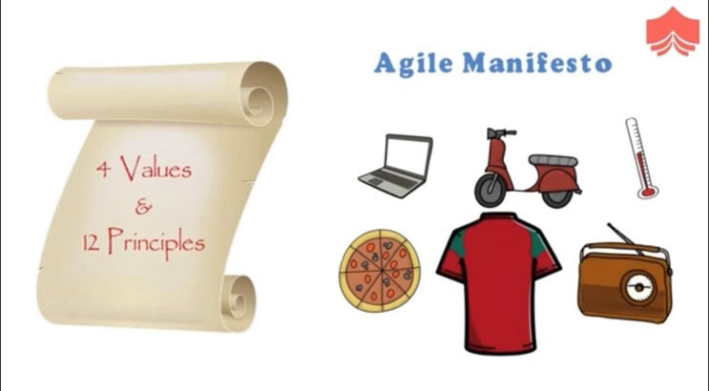
AGILE PRINCIPLES
The 4 basic
Agile Manifesto
values are:
Individuals and interactions over processes and tools
Working software over comprehensive documentation
Customer collaboration over contract negotiation
Responding to change over following a plan
Watch
“The 4 Values of Agile Manifesto Explained!”
You Tube Link
(6.5 mins)

Slide 27
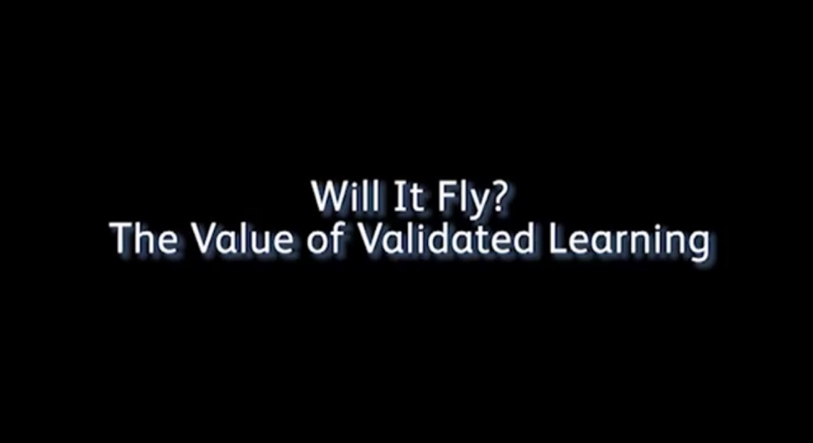
Lean validation
Watch “Lean Startup Lessons: Will it Fly? The Value of Validated Learning”
You Tube Link
(6.5 mins)

Slide 28
What you should ask while validating?
LEAN VALIDATION
Validate the problem. Is this a problem worth solving? If users don’t think this is a major problem, your solution won’t be appealing.
Validate the market. Some users might agree that this is a problem worth solving. But are there enough of them to make up a market for your product?
Validate the product / solution. The problem might exist, but does your product actually solve it?
Validate willingness to pay. There might be market demand and a great product. But will people actually be willing to reach into their wallets and pay for it?
Source: https://medium.com/lean-startup-circle/lean-validation-and-experimentation-b48eac3a1fbc

