Slide 1
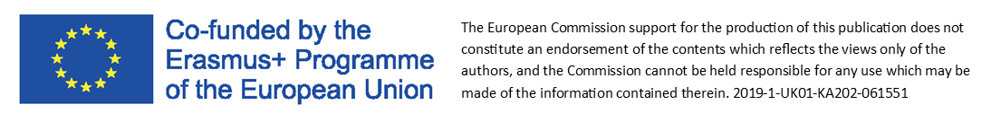
Module 6.
Marketing Lean Innovation

Slide 2
What we know already?
Source: https://nowymarketing.pl/a/21843,5-krokow-do-bardziej-efektywnych-dzialan-marketingowych-czyli-lean-marketing
Lean is based on continuous process improvement
Just 1% improvement per day or week, and the result will exceed our expectations
Small businesses have an advantage over the larger businesses they compete with, in that they are more agile and can align the whole organisation to a given goal across marketing, sales and operations, which can be next to impossible in big companies
Lean concepts can be successfully used in marketing processes

Slide 3

Around the world, thousands of new businesses with exciting new ideas for original products start up every day
Unfortunately, most of these ideas fail
Yet some go on to transform the way we live, eat, shop, work and pay for things
The most common causes of these problems include deficiency of:
Money
Talent
Intellectual Property
Access to distribution
Appropriate strategy
Sometimes all you need is marketing…
Lean Marketing
Source: https://www.smartinsights.com/goal-setting-evaluation/performance-management/principles-lean-marketing/

Slide 4
Marketing
Do I need it or not?
Most business owners understand the importance of marketing - in theory, at least
Usually, however, marketing ends up being an afterthought to a business owner's already-full schedule
Obstacles to Small Business Marketing:
1. Lack of time
According to Sage North America's survey of 6 million SMEs in the United States, 47% of small business owners are working more hours per week than they were five years ago, with the majority of them working longer days and most weekends. Since business owners are working more than ever, it's getting harder for them to squeeze in tasks that are outside their day to day operations
- and this includes marketing
2. Limited budgets
3. DIY Marketing Can Be Difficult
4. Lack of interest
One third of small businesses don't have a marketing budget
Companies with five or more employees are the most likely to outsource marketing tasks, according to a survey by Infusionsoft
But even when businesses get big enough to have more than ten employees, it's still usually the owner who takes the helm for marketing responsibilities
Source: https://business.tutsplus.com/tutorials/how-to-write-a-lean-marketing-plan--cms-26069

Slide 5
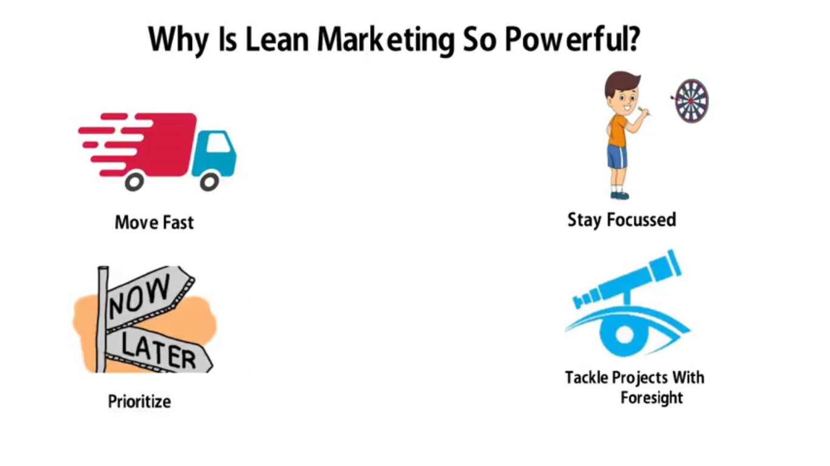



What is Lean Marketing?
BUILD
It’s a methodology pioneered by enterpreneur and author Eric Ries as it relates to product development at startups
The lean startup methodology is all about iterative shortened product releases and scientific experimentation
Lean marketing is a powerful tool that can help you become more agile and effective, and help you to make more efficient use of budgets
MEASURE
WATCH
LEARN
(2.0mins)
Source: https://www.youtube.com/watch?v=lFOKPrDF_JI
Source: https://moi-global.com/blog/lean-marketing-in-practice-6-top-tips-part-3/

Slide 6
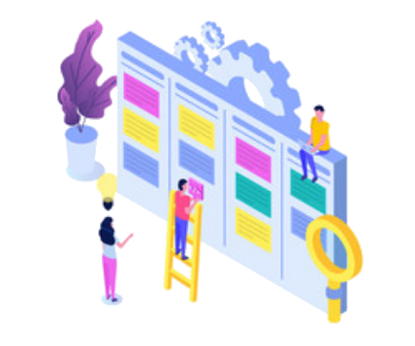
The basis behind this methodology is:
Change is inevitable!
Lean marketing, also known as Agile Marketing, is a process that lets businesses tweak their marketing strategies often, to analyse what’s working and what isn’t
That makes it easier to modify plans
Unlike traditional marketing where you put all your energy perfecting the final launch, only to find out it’s too late to make changes
Rather than investing significant time and resources into a product, website, or marketing campaign — and waiting until publication time to see how it performs — run experimental trials during the process
Fail early and fail often
You will save a lot of time and money learning from best practices
Source: https://cmgpartners.com/blog/what-is-lean-marketing/

Slide 7

Main assumptions of Lean Marketing:
Feedback
is the king
fast development - methodology based on cycles, sprints
goal orientation
action prioritisation - a specific timetable
maximising efficiency while minimising the amount of time and money
collecting feedback among testers and users
continuous testing of the beta version of the product until the final form
modernity and full transparency of activities
What kind of actions can we make
to collect feedback?
product launch and beta testing
post-launch feedback / recommendation collection system
advertising in contextual networks
business portals - Adwords ads
meetings of a small group of geeks and enthusiasts
activity on forums
Source: https://www.marketing-automation.pl/lean-marketing-niskobudzetowe-rozwiazanie-tylko-dla-start-upow/

Slide 8

Guiding Principles to Lean Small Business Marketing
1. Invest Only in What Matters Most
Whenever you're adding a marketing task to your to-do list, consider carefully whether your efforts and resources could be better spent on other opportunities that could bring in better results
2. Master the Art of "Little Bets"
According to entrepreneur and author Peter Sims, who popularised the idea, a "little bet" is "a low-risk action taken to discover, develop, and test an idea." Rather than focusing on big wins or huge returns, it's better to conduct low-cost and low-effort tests to see if a channel or tactic will work
Example of "Little Bets":
Instead of spending days brainstorming and writing ten new articles for your company blog, you can list a few topics you want to cover, and send the list to your readers via email or social media. Ask them to choose which ones they want to read about first.
3. Be Quick to Drop Things That Don't Work
Remember that when you eliminate a strategy that doesn't work - whether it's blogging, social media, or sending out flyers - you also eliminate hundreds of hours, tasks, and decisions that aren't going to bring you any tangible results. If your customer wouldn’t pay for something, it’s waste
Source: https://business.tutsplus.com/tutorials/how-to-write-a-lean-marketing-plan--cms-26069
https://www.planview.com/resources/articles/lkdc-lean-marketing/

Slide 9
Keep your lean marketing plan on a single page and just adapt it over time as you test your results
In a Lean Marketing plan you should include:
Your Target Customer
Describe your target customers and be as specific as possible
This information will come in handy as you choose the marketing strategies that will fit well with your audience
Customer Goals and Problems
As a reminder for the marketing messages you're going to create, write down your target customers' main goals and problems
Writing these items into your marketing plan can provide you with a reference you can use when planning your messaging
Focused Marketing Channels
After you reacquaint yourself with your target customers and their needs, go straight to selecting one or two marketing channels that you will use to reach out to them
Only one or two of the channels on this list have potential to give good returns on your invested time and money
You want to focus your resources on those high return channels
/
You'll make some mistakes and have failures along the way - and that's fine
Each new iteration of your marketing plan will be more effective and more accurate than the last one
Source: https://business.tutsplus.com/tutorials/how-to-write-a-lean-marketing-plan--cms-26069

Slide 10
Marketing channels
Offline Channels:
Cold calls
Newspaper classified ads
Phonebook classfied ads
Local TV ads
Local radio ads
Flyers
Posters
Direct mail
Affiliates
Referrals
Public speaking
Social Media Networks:
Facebook
LinkedIn
Twitter
Instagram
Snapchat
Pinterest
YouTube
Other Online Channels:
Guest posting
Email marketing
Cold emails
Your Own Website:
Blogging
Whitepapers
Ebooks
Podcasting
Case Studies
Review Sites:
Yelp!
InsiderPages
Citysearch
LinkedIn users tend to be professionals
(target – business community)
Snapchat users tend to be between 18 to 24 years old
(target - younger audience)
Specific Marketing Strategy for Each Channel – case study
Source: https://business.tutsplus.com/tutorials/how-to-write-a-lean-marketing-plan--cms-26069

Slide 11

What should a small enterprise should think about
when practising Lean Marketing?
The opportunity cost of doing A is that you cannot also do B
Decisions are interdependent
To avoid cost overruns, delays and growing flabby, you need to always consider the flip side of every decision. If you tell your development team of three coders to build an extra feature into the new app that you are building, you must make that decision at the cost of other features. That may well mean it is the wrong decision.
Need to Have
Nice to Have
Did you know that...?
Creators of Instagram originally built a mobile app-based social network which was built around checking into locations, making plans with friends and sharing experiences. They quickly realised users loved using it to share photos, but not much else. Instead of devoting resources to improving the features the app was originally built around, they scrapped all the features except photo sharing and built the best app they possibly could just around that.
Source: https://www.smartinsights.com/goal-setting-evaluation/performance-management/principles-lean-marketing/

Slide 12

What should a small enterprise think about
when practising Lean Marketing?
Simple Market tests can be useful, but can't always be relied on
Market viability can also be tested through creating landing pages and then advertising a forthcoming proposition through targeting in Google AdWords or social media
Sometimes customers need time to appreciate the value of a new product
Vice versa, sometimes initial usage is a poor guide for future usage:
- fleeting gimmicks lead to a rush of users which quickly dissipate
Groupon is a prime example of this:
- Massive early take up quickly dissipated when customers found that repeated use was uneconomical
Try to start up genuine conversations with users and generate qualitative feedback
Align the entire organisation
If the end goal requires a product built with collaboration between many different teams, you can configure the whole organisation, even the layout of the building, to maximise collaboration. Similarly, if you find there are activities which are not contributing to the overall goal, then removing them can help boost efficiency and save money
Source: https://www.smartinsights.com/goal-setting-evaluation/performance-management/principles-lean-marketing/

Slide 13

Meet 5 steps for more effective marketing activities
Step 1 – KISS (keep it simple, stupid) – Focus on the elements that work
Set a goal for each activity and measure it. Develop the channels that bring the best results
Run regular quick tests and experiments that you will close in a build-measure-learn loop
Regularly (e.g. once a month) review trends, new tools and test selected ones
Step 2 – MVP (minimal viable product) which is created to test an idea, concept, channel, method etc
Example: Are you wondering whether to add a bookmark from the video case study to the site?
First create a video and distribute it through channels that you already use, e.g. Facebook, LinkedIn
Set a measurable goal - implement it on your website only after the test material meets the assumptions
Source: https://nowymarketing.pl/a/21843,5-krokow-do-bardziej-efektywnych-dzialan-marketingowych-czyli-lean-marketing

Slide 14
Meet 5 steps for more effective marketing activities
Step 3 – Say stop to waste. Determine which steps are unnecessary, which can be eliminated, automated or simplified without loss or with a slight loss of value. Pay special attention to the decision-making process, as well as bottlenecks in the process.
Step 4 – Use the "just in time" principle. Don't overload employees with tasks - set priorities for them for a given month / week / day and discuss these during short meetings (e.g. weekly planning, daily standups). Do not assign further tasks unless previous tasks have been completed.
Step 5 – Close the process in iterations (referring to agile methods). Focus on delivering a specific goal in weekly, biweekly, monthly sprints. Divide the goals and tasks into smaller parts, which can be achieved in a specific, shorter period.
Source: https://nowymarketing.pl/a/21843,5-krokow-do-bardziej-efektywnych-dzialan-marketingowych-czyli-lean-marketing

Slide 15

Advantages of lean marketing:
1. You move fast
Short iterative cycles allow you to adapt quickly to changing marketing conditions
2. You Stay Focused
At the beginning of each sprint, you choose the projects - the only projects - that you'll work on during that given sprint
The main benefit is launching the product as soon as possible in order to quickly verify the quality and usability of the offered solutions
The idea is to work and develop your products as effectively as possible at the lowest cost
3. You Prioritize
Every project has a clear and distinct goal, success metric, evaluation of effort required, and a forced priority
A daily "burndown" (a chart that shows the amount of work left to be completed in the sprint, compared to the current goal) shows how the team is progressing toward completing all their projects
4. You Tackle Projects
With Foresight
Lean marketing = low-budget marketing
Low budget does not mean anything bad in this case
It is extremely difficult to reach exactly where we want, and where our customers are, for a rock-bottom cost
Source: https://blog.hubspot.com/lean-marketing-how-to-run-your-marketing-team-like-a-startup.aspx
https://www.marketing-automation.pl/lean-marketing-niskobudzetowe-rozwiazanie-tylko-dla-start-upow/

Slide 16

Lean marketing provides a better way and reduces
the risk of failure
by acknowledging failure within the process
– accepting it
and making swift and informed changes to
evolve the
plan along
the way
In addition, based on Lean Marketing, we can also:
Keep the organisation customer-focused
Improve speed-to-market
Make teams more productive
Deliver better, more relevant end-products
Increase throughput/velocity of work delivered
Source: https://cmgpartners.com/blog/what-is-lean-marketing/
https://www.ironpaper.com/webintel/articles/what-is-lean-marketing/

Slide 17

Here are some helpful questions to answer if you want to make marketing more lean:
Customer Discovery & Development:
What are high-value customer problems?
Which aspects of our product/service solves these problems?
Who specifically is our customer?
Who makes or influences the buying decisions?
Customer Testing & Validation:
How can we provide value to our customers and make them happy?
Customer Growth:
What will make our customers grow and share our product/service exponentially?
Brand Building:
How do we make our customers feel awesome?
How do we make the company growth sustainable?
Source: http://contentboxter.com/lean-marketing/

Slide 18

To sum up…
Lean marketing is about using a feedback loop, data, iteration and validation, to build success with marketing efforts quickly
Lean marketers study results of small, trial campaigns, learn from the results, and evolve the elements of the campaign
Lean marketing is always iterative. Build and create small ideas, get them into market quickly, measure the results, learn, and iterate using the lessons learned
For Lean marketers, a commitment to continuous improvement is a way to ensure that the things you are spending your time on are actually generating the most value for your customers
Tools that you can use in practice:
Google Analytics
Hubspot – enterprise version
Adwords
optimizely.com
Source: https://www.ironpaper.com/webintel/articles/what-is-lean-marketing/
https://www.planview.com/resources/articles/lkdc-lean-marketing/

Slide 19

Lean Marketing Strategies for Small and Micro Businesses
Read the article and think about how you can implement the concept of lean marketing
in micro businesses
Source: https://www.crowdspring.com/blog/lean-marketing/

Slide 20



Sources:
https://www.youtube.com/watch?v=lFOKPrDF_JI
https://nowymarketing.pl/a/21843,5-krokow-do-bardziej-efektywnych-dzialan-marketingowych-czyli-lean-marketing
https://www.smartinsights.com/goal-setting-evaluation/performance-management/principles-lean-marketing/
https://business.tutsplus.com/tutorials/how-to-write-a-lean-marketing-plan--cms-26069
https://moi-global.com/blog/lean-marketing-in-practice-6-top-tips-part-3/
https://cmgpartners.com/blog/what-is-lean-marketing/
https://www.marketing-automation.pl/lean-marketing-niskobudzetowe-rozwiazanie-tylko-dla-start-upow/
https://www.planview.com/resources/articles/lkdc-lean-marketing
https://blog.hubspot.com/lean-marketing-how-to-run-your-marketing-team-like-a-startup.aspx
https://www.ironpaper.com/webintel/articles/what-is-lean-marketing/
http://contentboxter.com/lean-marketing/
https://www.crowdspring.com/blog/lean-marketing/

Slide 21

Task
Prepare a Lean Marketing plan for a product you want to implement in a small business
Describe your target customer. Include their demographics, location, and the industry they are in.
Write down your target customers' main goals and problems. What are the goals your company is helping them accomplish? What problems are you solving for them?
Select one or two marketing channels that you will use to reach out to them.
The duration of the exercise is 25 minutes.

Slide 22
Example
One way to foster your marketing activity is to join a loyalty programme offered by various apps
Inforapps
Web: https://inforapps.es/
Inforapps is focused on software development in Burgos
They carry out projects for all kind of companies that use IT products
They are experts in web pages, mobile apps, Big Data and cloud solutions

Slide 23
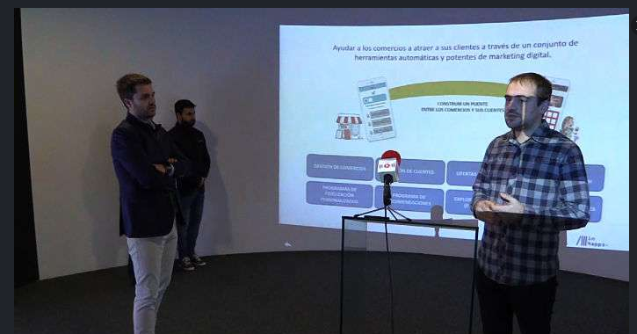
History of Inforapps:
First of all, Inforapps started this project as something personal
The first idea was to replace the typical loyalty paper cards with points from the shops into something digitalized
With this app, users were going to carry their “cards” in a simple app, where they also receive offers
Inforapps participated in the Open Future program for young entrepreneurs with their app. During the program they established contact with a trade association “Zona G” from a neighbourhood of Burgos. Zona G were interested in the product, so with this contact, Inforapps started to develop the changes that they suggested. They tested the app with representatives from the association.
Example

Slide 24
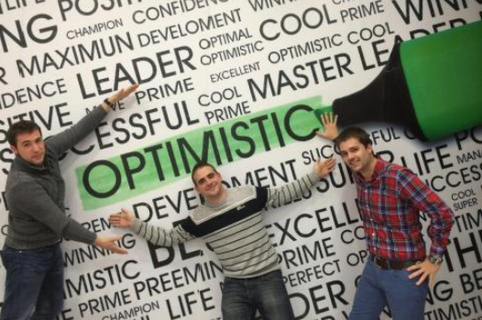
Solution
The first time that final users could install the app in their devices was in the Gangamania Event
Users found all the shops from the Zona G association and they could interact with the shops through the app, share comments, see offers, etc
After Gangamania, Inforapps only had to complete some minor changes in the app
Example
As an example of continuous improvement, to cope with the COVID-19 situation, Inforapps have included new actions to enable users to:
book an appointment date in a shop
make a Click and Collect order, or
select home delivery

Slide 25

A commitment
to continuous improvement is a way to ensure that the things you are spending your time on, are actually generating the most value for your customers
Work smarter,
learn lean marketing

