Slide 1

Module 7.
Lean Innovation Processes

Slide 2

Business Survival rests on meeting the ever-changing needs of customers efficiently, using minimal resources
This is achieved through internal innovation for the improvement of all processes
A process is a set of consecutive activities that are logically ordered and implemented in order to achieve the intended result from which the client will benefit
That’s why there is a need to Focus on Lean Innovation Process

Slide 3

What is Process Innovation?
It is the implementation of a new process, that significantly improves a service, production or distribution method
It covers significant changes in techniques, equipment and software
Process innovations don’t include:
minor changes
an increase in production or service capacity gained by adding processes or logistics systems that are very similar to those currently used
Not every process innovation requires research in order to be implemented
Source: https://old.cpe.gov.pl/pliki/1211-2012.pdf

Slide 4
Examples of process innovations:
a) goods
installation of new or improved production technology, such as automation equipment or real-time sensors, that can better adapt processes to needs
new equipment related to the production of new or improved products
laser cutting tools
automated packaging
computer aided product development
computerised equipment for production quality control
improved testing of production monitoring equipment
The key to Lean Innovation process is to embrace creativity and change,
but in a smart way –
using an approach that minimises risk while increasing customer value
Source: https://www.northeastern.edu/graduate/blog/what-is-lean-innovation-and-why-use-it/
Source: http://innowacjeproduktowe.weebly.com/innowacje-procesowe.html

Slide 5

Examples of process innovations:
Lean Innovation Process is focused on increasing efficiency by capturing customer feedback early and often and minimising waste in the product development cycle
b) Delivery and operations
portable scanners / computers for registering goods
implementation of bar coding or radio frequency identification (RFID) chips to track materials flowing through the supply chain
GPS tracking in transport equipment
software introduction to identify optimal delivery routes
new or updated software, procedures for purchasing, accounting, storage
implementation of electronic billing systems
implementation of a system for automatic voice control
new tools and software that designs improved inventory flow
new or significantly improved computer networks
Source: https://www.northeastern.edu/graduate/blog/what-is-lean-innovation-and-why-use-it/
Source: http://innowacjeproduktowe.weebly.com/innowacje-procesowe.html

Slide 6

Innovations are important for micro businesses to emphasise their major competitive advantages, such as better communication and simpler business structures that can implement new ideas faster.
In the process approach, the organisation should be treated as a set of processes and described as a map of connections and process sequences
This makes it easier to implement process innovations
MANAGEMENT
PROCESSES
CUSTOMERS
Source: https://docplayer.pl/6398247-Zarzadzanie-projektami.html

Slide 7
How to improve processes in a small company and be more innovative?
Did you know
In 1913, Henry Ford introduced the first moving assembly line, a manufacturing process that dropped assembly time for a single vehicle from 12 hours to 90 minutes. By reducing the time, money, and human capital required to build a car, Ford was able to lower the cost of the company’s popular Model T from $850 to less than $300, making automobiles more accessible to the masses
The increased efficiencies in the system helped eliminate “waste,” all while improving the customer experience – core principles to lean innovation
Toyota later replicated Henry Ford’s original principles at the Rouge assembly plant, using Ford’s approach as a basis for developing the Toyota Production System
Set aside an hour each week to think and exercise your creativity
Build innovation into your business planning by setting goals that focus on improving processes (for example try out a new way to communicate with your customers)
Create an innovation action plan to implement your innovation goals
Use both formal and informal methods to get customers to make suggestions for innovation, such as questionnaires, surveys, and casual one-on-one conversations
Talk to your suppliers and see what suggestions for improvement they might have
Continue to educate yourself about innovation by attending workshops, webinars, conferences, reading blogs and articles, etc.
Stay on top of developments, technological and otherwise, in your industry
Source: https://www.thebalancesmb.com/kickstart-business-innovation-2947877
https://www.northeastern.edu/graduate/blog/what-is-lean-innovation-and-why-use-it/

Slide 8

How to involve staff in the innovation process?
Make problem-solving a part of every staff meeting For each meeting, for instance, you might set a question for discussion on a specific process that asks, "How can we improve...?“ Publicise the topic of discussion a week ahead of time so people have time to think about it
Have a suggestion box
Reward staff for suggestions that are enacted
Talk to staff Get out of your office if you have one and make personal visits to chat about how things are going
Provide creativity/innovation workshops for staff
Source: https://www.thebalancesmb.com/kickstart-business-innovation-2947877

Slide 9
The process approach to implementing innovation in small enterprises allows the small business to:
Companies need to be fast-moving, and their employees need to be comfortable with assessing the global landscape and enabling their organisation to change and take risks
The Lean Innovation process allows firms to explore more opportunities, mature these quickly and at low cost, and test these to see if they are worth the investment
Improve communication and cooperation within the company, as well as improving the organisational culture and working atmosphere in teams
improve the effectiveness of cooperation with clients
shorten production cycles
reduce the number of mistakes made
ensure all staff understand the principles and functioning of the organisation.
Source: https://www.northeastern.edu/graduate/blog/what-is-lean-innovation-and-why-use-it/

Slide 10
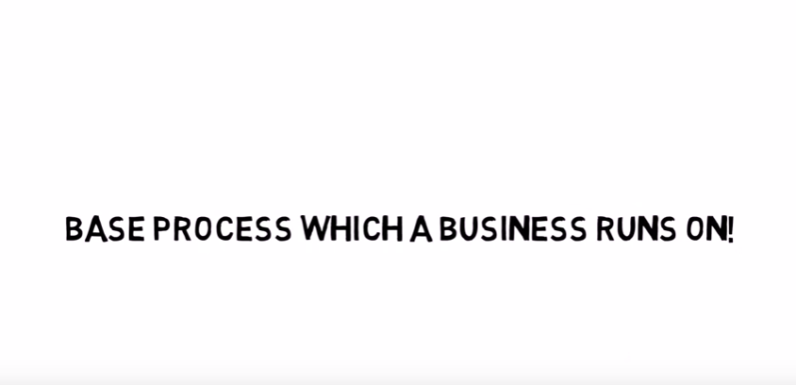
THE PDCA CYCLE
This is an important tool to help a micro business change more rapidly than large companies.
This model is also called the Deming cycle
The PDCA cycle was originally developed by Walter A. Shewhart, a Bell Laboratories scientist who was Deming’s friend and mentor, so sometimes this is referred to as the “Shewhart Cycle”
Plan
set goals and processes necessary to deliver results in line with customer requirements
Do
implement processes (changes in processes)
Check
check and measure processes
Act / Adjust
take action on continuous improvement of the process
Watch
How to improve the work we do in an easy and simple way
(3.0mins)
Source:https://balancedscorecard.org/bsc-basics/articles-videos/the-deming-cycle/

Slide 11
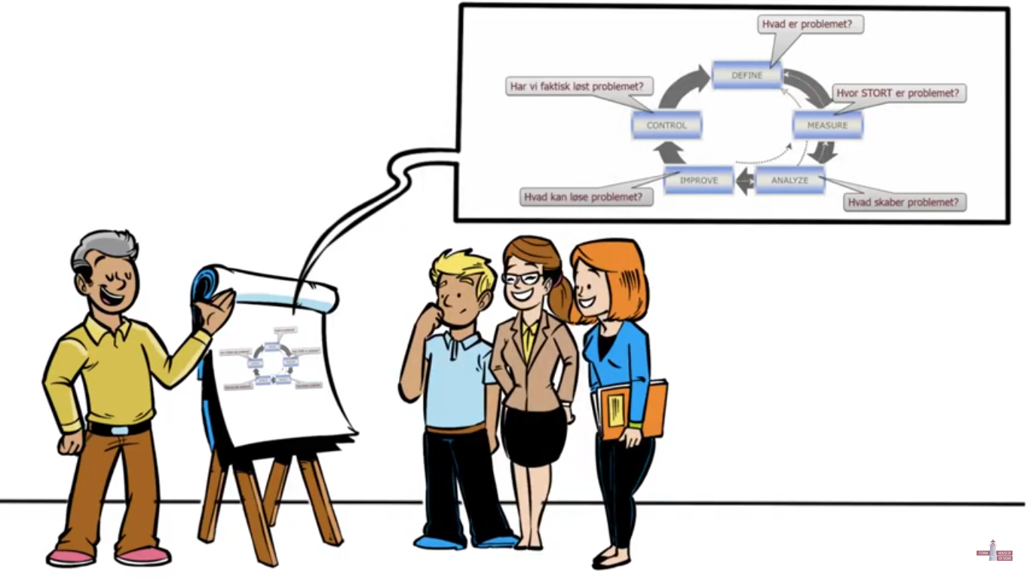
DMAIC enables:
- an objective view of the process
- an understanding of the problem encountered
- the determination of what needs to be done to implement changes that will improve a faulty / imperfect process
DMAIC is a data-driven quality strategy for improving processes
The DMAIC cycle has five procedures
These should be carried out systematically to eliminate defects from business processes, and improve them so that they are as close as possible to the ideal solution
Define
Measure
Analyse
Improve
Control
Control future process performance to prevent degradation of improved process
Define the project goals and customer (internal and external) deliverables
WATCH
Applying DMAIC in a small business
DMAIC
cycle
Improve the process by eliminating defects
Measure the process to determine current performance and quantify the problem
Analyse and determine the root cause(s) of the defects
(4.0mins)
Source: https://www.isixsigma.com/new-to-six-sigma/dmaic/what-dmaic/
Source: https://www.youtube.com/watch?v=R50llXT_xrY

Slide 12

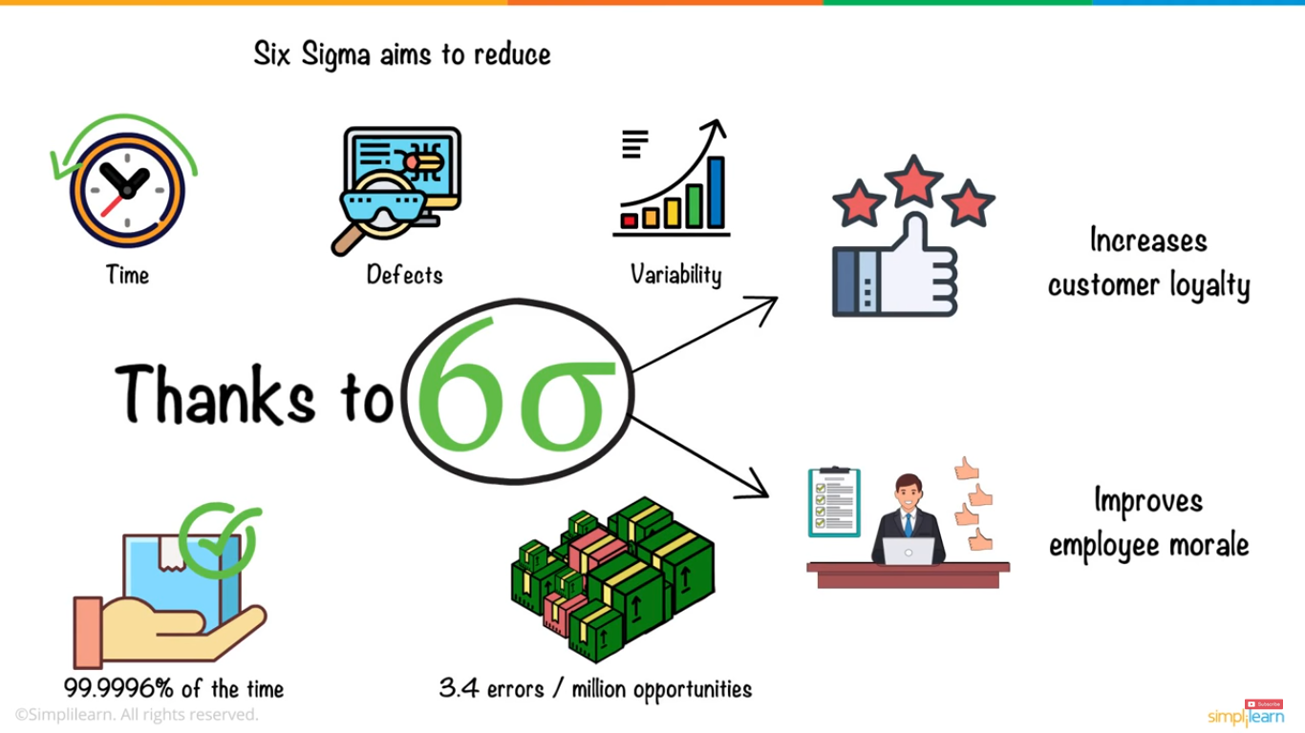
DMAIC is an integral part of the Lean Six Sigma approach
Lean Six Sigma is a method that relies on a collaborative team effort to improve performance by systematically removing waste and reducing variation
It focuses on eliminating the eight kinds of waste:
WATCH
6 Sigma in 9 Minutes
Defects
Over-Production
Waiting
Non-Utilized Talent
Transportation
Inventory
Motion
Extra-Processing
Source: Tapas K. Das, Industrial Environmental Management: Engineering, Science, and Policy
Six Sigma in 9 Minutes

Slide 13
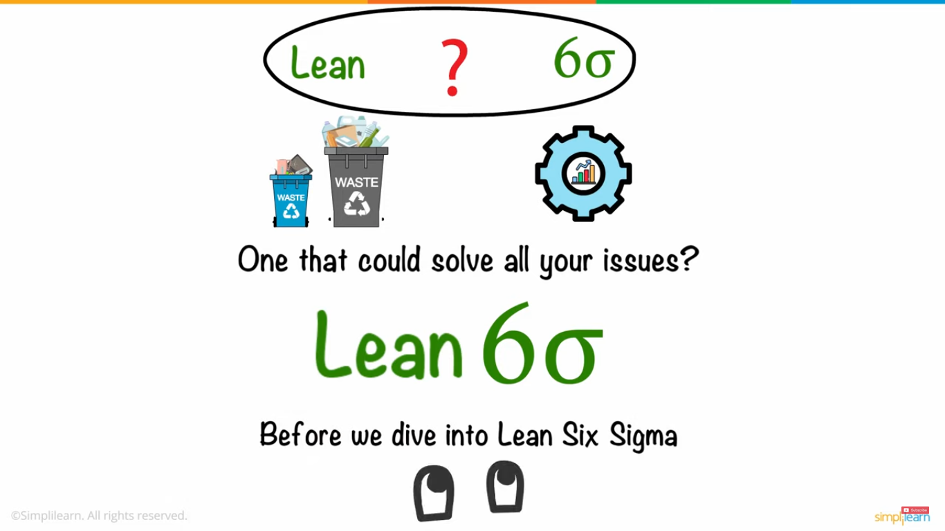
Lean Six Sigma
Lean Six Sigma not only reduces process defects and waste, but also provides a framework for overall organisational culture change
By introducing Lean Six Sigma, the mindset of employees and managers change to one that focuses on growth and continuous improvement. This change in culture and mindset of an organisation maximises efficiency and increases profitability
In order to successfully implement Lean Six Sigma, a combination of tools can be used
Some of these tools include:
WATCH
You Tube Link - Lean 6 Sigma for the small business
Kaizen
value-stream mapping
line balancing
visual management
(8.0 mins)
Source: Tapas K. Das, Industrial Environmental Management: Engineering, Science, and Policy

Slide 14
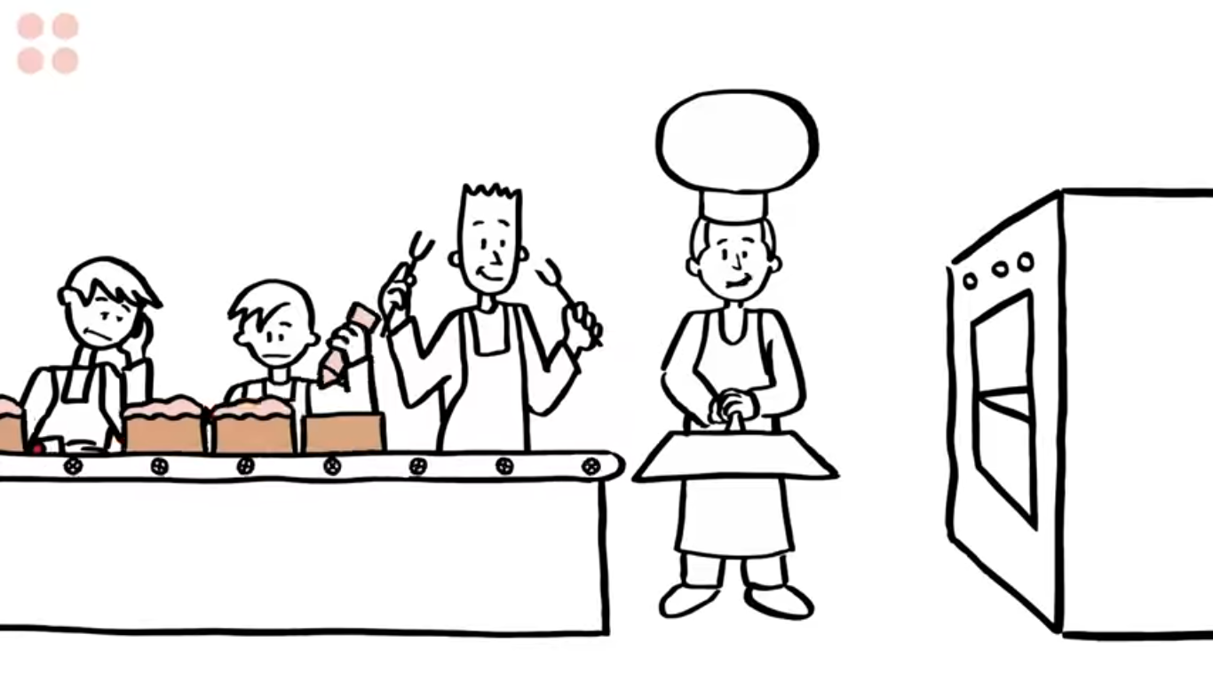
This concept supports:
An increase in competitive ability
An increase in work efficiency, flattening hierarchy, shortening decision-making time
More attention to the needs and wishes of customers
Increased employee satisfaction due to better communication between managers and staff
More motivated employees that identify with the company's successes
Lean Management
Is all about significantly reducing the resources needed for production: people, space, investment outlays, time, etc.
WATCH
Get Lean in 90 seconds
Source: J. Liker, The Toyota Way: 14 Management Principles from the World’s Greatest Manufacturer

Slide 15
The differences between traditional management methods and lean management
Traditional approach | Lean Management
functional structure, minimal qualifications, long production cycles, large amount of inventory individualism in organisation guided by orders and coercion loyalty and obedience, alienation and rebellion narrow information based on reports generated by, and for, management product development isolated with little customer impact, independent of productive reality | process structure, high qualifications, stream production, zero inventory task teams, flat organisational structure guided by visions and participation harmonious co-operation based on long-term human resource development broad information, based on system control carried out by all employees product development and production process in line with customer requirements
Source: R. Harris, Lean Production Implementation

Slide 16

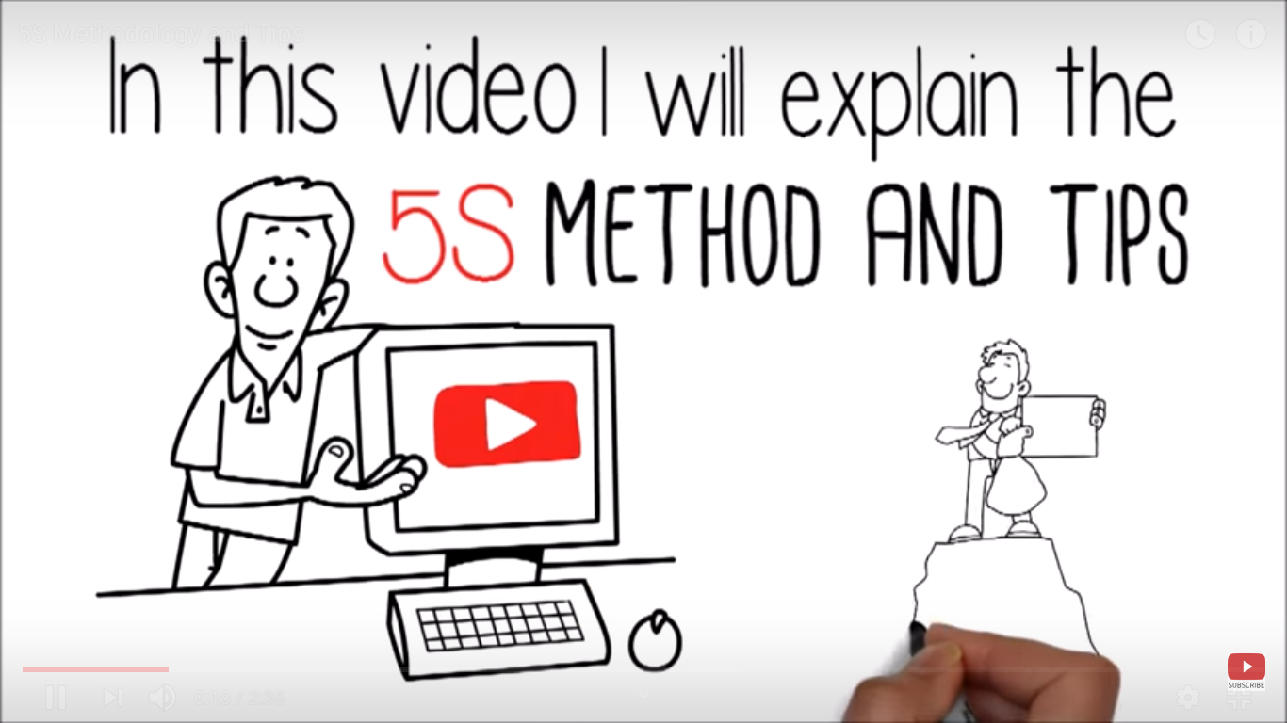
Meet 5S – one of the most important tools of Lean Management
1 – Sort
2 – Set in order
3 – Shine
4 – Standarise
5 – Sustain
WATCH
5S is a systematic tool that creates functional order within a company
5S accomplishes this with the five S’s
Source: https://www.graphicproducts.com/articles/lean-manufacturing-process/
https://www.youtube.com/watch?v=8gKJ3_Hm3dM

Slide 17
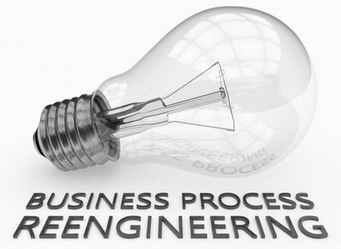
Sometimes we need radical changes in our business
In this case BUSINESS PROCESS RE-ENGINEERING is the solution
Fundamentally
rethinking
The authors of the re-engineering concept
are M. Hammer and J. Champy
They recommend that any existing rules in the organisation be thrown overboard
You must completely free yourself from the past because without this it is impossible to radically cure the enterprise
Radical
redesign
Re-engineering
means:
Dramatic
improvement
Source: M. Hammer, J. Champy, Reengineering the Corporation. A Manifesto for Business Revolution

Slide 18
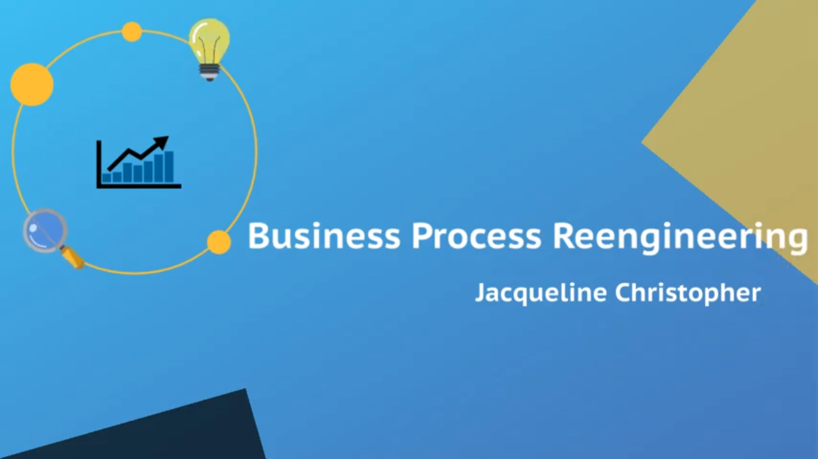
Here are some rules of re-engineering:
Organise around results, instead of tasks
Process output generators should work on the process
Use scattered resources as if they are centralised
Combine parallel functions, not just their results
Let people who produce information, process it
Build controlled processes
Record information only once
Watch
(4.5 mins)
Source: https://drewduboff.com/business-process-reengineering
https://www.youtube.com/watch?v=IZHqAo4QryE

Slide 19


Advantages and disadvantages of re-engineering
Causes of failures:
ERROR NO. 1 –
No clear visions
ERROR NO. 2 –
Unrealistic expectations
ERROR NO. 3 –
Inadequate resources
ERROR NO. 4 –
Too long delivery time
ERROR NO. 5 –
Lack of appropriate management support
ERROR NO. 6 –
Technocratism
Advantages | Disadvantages
holistic, supra-departmental thinking and action increase in efficiency shortening the duration of processes | authoritarian style of management while implementing the concept skipping employees during the preparation of the reorganisation high implementation costs neglecting cultural aspects, which creates the danger of strong resistance to change
Source: M. Hammer, J. Champy, Reengineering the Corporation. A Manifesto for Business Revolution

Slide 20



Re-engineering – success stories
FORD
GOOGLE
AIRBNB
Problem: Ford’s accounts payable division was not as efficient as it should be
The company found that the department was overstaffed and approximately 5 times larger than necessary
Solution: Deploy a BPR strategy to change the accounts payable process
Ford reorganised and downsized the department and came up with new processes
This helped the company become more productive
Problem: The company’s hiring process was ineffective. Google had found that their hiring process had little correlation with how a candidate ultimately performed in their job
This led to bad hires that left negative, long-lasting effects on the company
Solution: Adopt a structured, process-driven approach to hiring and interviewing candidates
Google re-engineered its hiring process and developed a structured approach to interviewing candidates
Consequently, the company spent fewer resources and capital when hiring new staff and can better weed out toxic employees
Problem: The employees involved in Airbnb’s product development process – designers, engineers, and researchers – were working in silos
This was counterproductive and caused them to struggle with meeting their deadlines
Furthermore, it also resulted in mediocre product ideas
Solution: Create a digital environment where employees can work closely together
The company came up with a system that updated files in real-time, allowing the designers, engineers, and researches to work seamlessly together
This enabled them to deliver great product ideas punctually
Source: https://www.astreem.com/business-process-reengineering/

Slide 21
Try to constantly improve processes
Continuous improvement is the foundation of the lean process
More commonly referred to as Kaizen, continuous improvement supports the lean process by creating a culture where every worker - from the CEO to the production floor assistant - looks for ways to improve the company
Generally, individual improvements are relatively small; however, over time, the changes result in major improvements
A culture of continuous improvement can be cultivated in the workplace by:
Communicating
the positive effects
Welcoming all suggestions
Showing trust
Source: https://www.graphicproducts.com/articles/lean-manufacturing-process/

Slide 22



Sources:
Websites:
Videos:
Other sources:
https://old.cpe.gov.pl/pliki/1211-2012.pdf
http://innowacjeproduktowe.weebly.com/innowacje-procesowe.html
https://www.northeastern.edu/graduate/blog/what-is-lean-innovation-and-why-use-it
https://docplayer.pl/6398247-Zarzadzanie-projektami.html
https://www.thebalancesmb.com/kickstart-business-innovation-2947877
https://balancedscorecard.org/bsc-basics/articles-videos/the-deming-cycle
https://www.isixsigma.com/new-to-six-sigma/dmaic/what-dmaic
https://www.graphicproducts.com/articles/lean-manufacturing-process
https://drewduboff.com/business-process-reengineering
https://www.astreem.com/business-process-reengineering
http://www.tpslean.com/resultsall.htm#antenna
https://www.youtube.com/watch?v=8T1sYPrQqvY
https://www.youtube.com/watch?v=R50llXT_xrY
https://www.youtube.com/watch?v=4EDYfSl-fmc
https://www.youtube.com/watch?v=s2HCrhNVfak
https://www.youtube.com/watch?v=wfsRAZUnonI
https://www.youtube.com/watch?v=8gKJ3_Hm3dM
https://www.youtube.com/watch?v=IZHqAo4QryE
Tapas K. Das, Industrial Environmental Management: Engineering, Science, and Policy
J. Liker, The Toyota Way: 14 Management Principles from the World’s Greatest Manufacturer
R. Harris, Lean Production Implementation
M. Hammer, J. Champy, Reengineering the Corporation. A Manifesto for Business Revolution

Slide 23

Try to recommend lean process innovation in a typical small business
Think about elimination waste (muda):
Defects
Over-Production
Waiting
Non-Utilized Talent
Transportation
Inventory
Motion
Extra-Processing
The duration of the exercise (in groups) is 30 minutes.
Task

Slide 24

Implement lean innovation process in your business:
increase the value delivered to your customers,
decrease the cost of doing business,
increase profitability

