Slide 1

Module 8:
How to Foster Creativity

Slide 2

If innovation is understood as a process of using new ideas and transforming them into new products, then creativity should be understood as the source of new (innovative) and useful ideas
From this perspective, creativity is the beginning and the cause of various forms of innovation
We are all creative
How can human creativity be stimulated
?
Source: J. Lichtarski, M. Trenkner, On the co-existence of innovation and creativity in the lean management environment

Slide 3
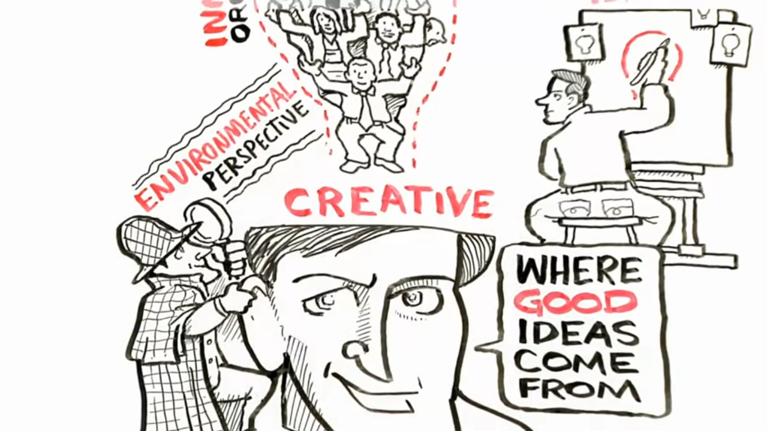

Creativity, what is it?
WATCH
Where Good Ideas Come From
Creativity is defined as a mental process
the result of which is the emergence of new ideas, new solutions, new products that are considered useful
(4.0mins)
Source: https://www.youtube.com/watch?v=NugRZGDbPFU
Source: A. Wojtczuk-Turek, Rozwijanie kompetencji twórczych

Slide 4
Conditions for creativity:
a) Individual personal features and skills:
persistence
the need for autonomy
focus on risk
independent thought and assessment
restraint from judgments
freedom of action
generating many ideas
developing the ideas of others
lack fear of failure or being ridiculed
positive attitude of employees and the team
intuition
Did You know that…
In 2010, IBM conducted a survey of more than 1500 CEOs of various organisations around the world, about which competences, in their opinion, were the most important for leaders in an organisation.
It turned out that among answers such as discipline, managerial competences, integrity, team management or creating an inspiring vision, creativity was the most crucial factor to navigate an increasingly complex world.
Source: https://www.prawo.pl/kadry/dlaczego-skrzynka-pomyslow-juz-nie-wystarczy,279443.html
Source: J. Lichtarski, M. Trenkner, On the co-existence of innovation and creativity in the lean management environment
S.J. Parnes, Optimize the magic of your mind

Slide 5
Conditions for creativity:
In times of constantly growing complexity in business, creativity allows for effective management of the organization, thanks to the ability to create new solutions that:
- challenge the status quo
- take a balanced risk when creating and implementing innovative solutions
- engage employees to create innovations
This leads to the generation of ideas for new solutions, products, services or changes in the business model of the organisation.
b) Conditions created by environment:
demand for a new solution (“necessity is the mother of invention”)
ensuring a friendly atmosphere at the workplace
freedom of action (autonomy)
supporting organisational culture
support of management
support of the team
sufficient resources (materials, work conditions, information)
encouraging employees to submit various ideas
creating an atmosphere of cooperation in the group
fostering discussion and sharing information
using awards for creative attitudes
Source: https://www.prawo.pl/kadry/dlaczego-skrzynka-pomyslow-juz-nie-wystarczy,279443.html
Source: J. Lichtarski, M. Trenkner, On the co-existence of innovation and creativity in the lean management environment
T.M. Amabile, Motivating creativity in organization: On doing what you love and loving what you do
G.D. Hughes, Add creativity to your decision process

Slide 6
The creativity of employees should be treated as a key competence, and employers should create an environment in their company that will be conducive to the creation and implementation of innovative solutions
implement a culture supporting the creativity of employees in the organisation
more creative employees
=
more ideas
more ideas
=
a greater chance for true innovation that sets us apart from the competition
real innovation
=
real business profit for the organisation
Source: https://www.prawo.pl/kadry/dlaczego-skrzynka-pomyslow-juz-nie-wystarczy,279443.html

Slide 7

Why can a culture supporting employee creativity have such a big impact on employee satisfaction and commitment?
Mostly because people naturally want to be successful at work, have a sense of influence over what is happening around them, and create something in their work
This is especially visible in the case of young employees currently entering the labour market, for whom the main value at work is the possibility of self-realisation and creating something new and which is their own
It is this phenomenon that harnesses the culture of creativity in the organisation to the benefit of the company
Source: https://www.prawo.pl/kadry/dlaczego-skrzynka-pomyslow-juz-nie-wystarczy,279443.html

Slide 8


You should look for new solutions because:
– an action isn’t always good just because we do it
– a method isn’t always good just because we use it
– a device isn’t always good just because we have it
Watch
Lean Management and Creativity
We may encounter an opinion that Lean, due to standardisation, limits creativity
However, the standards on which Lean is based should be subject to continuous innovation
They are merely the best way to carry out certain tasks in a given time, serving as a reference for future innovations
Source: N. Thomas, Kreatywność i innowacje według Johna Adaira
J. Miller, M. Wroblewski, J. Villafuerte, Kultura kaizen
(1.75 mins)
Source: https://www.youtube.com/watch?v=w50-Kwn8MLY

Slide 9
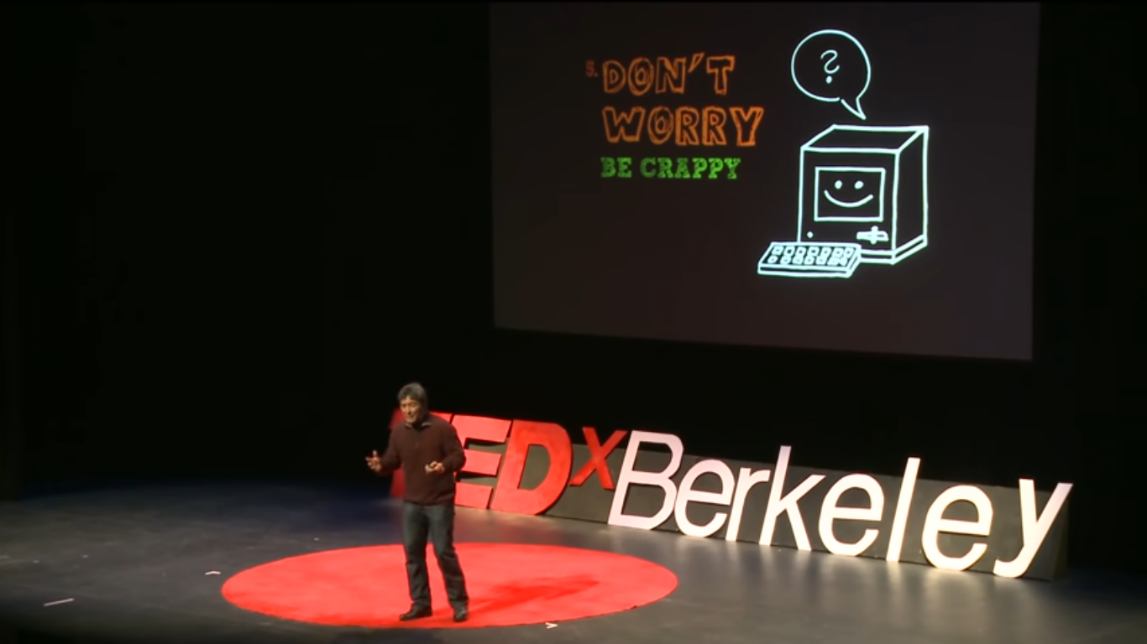
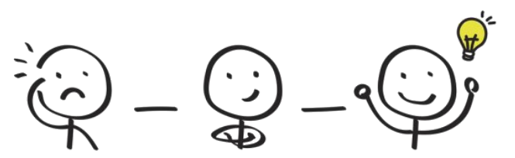
“ You should never impose your views on the problem being solved on anyone.
You just have to investigate the problem and the solution will come by itself. ” Albert Einstein
Abilities and skills useful in the creative process:
memory
visualisation
creation
prediction
imagination
Don't be afraid to use phrases such as:
"would it be better if..."
"I’ve got this brilliant idea..."
“We could do it this way..."
"This would be a great business, but we would need..."
WATCH
The Art of Innovation
Source: https://www.youtube.com/watch?time_continue=464&v=Mtjatz9r-Vc&feature=emb_logo
(21.25 mins)
Source: https://artgym.com/neuroscience-and-creativity/

Slide 10

In creative problem solving, you should use the following principles:
The principle of diversity
2. The principle of deferred evaluation
3. The principle of rational irrationality
4. The ludic principle
5. The principle of topicality
Source: https://szkolenia.avenhansen.pl/szkolenia-zamkniete/trening-tworczego-myslenia.html

Slide 11

6 Elements for creating a culture of creativity
in an organisation:
Project goal (Why do we want to implement a culture for creativity in the organisation?)
Ideas (What initiatives do we expect from employees? In what business areas do we need innovation?)
Evaluation and Selection (How do we evaluate and select the best ideas from all submitted?)
Awards (How do we reward idea creators?)
Implementation (How do we implement innovations? Do we create new implementation paths for innovative projects?)
Support for creators (How do we support the creators of ideas during the process of research and development of solutions, as well as in the process of implementing them in the organisation?)
Source: https://www.prawo.pl/kadry/dlaczego-skrzynka-pomyslow-juz-nie-wystarczy,279443.html

Slide 12
How to enhance creativity
in a micro business?
First of all, you should focus on team creativity
The team is two or more individuals, interacting and interdependent, with whom you are going to work in order to achieve a goal
Tapping into creativity is the key that keeps your team competitive and young, no matter the age, in a market that is a constant battlefield fighting to stay relevant
Here are some suggestions to make your team more creative:
If you want to develop team creativity, make sure that you give them the margin and space in their lives to think and act creatively
As a leader, look for, and encourage, opportunities for your team
Understand that everyone has creativity
Engage Your Hands
Play and
make fun
Remember that everyone wants to use their creativity
Give space for creativity
Understanding that creativity rests inside of every person, allows you as a leader to see not only yourself, but also your team, as an incredible source of creative potential.
Instead of just thinking about the solution, get some LEGO bricks and build the solution (for example build your perfect client)
It is when our minds are free to experiment, free to learn, free to enjoy and laugh, that some of our best ideas and insights come
Source: https://theheart.tech/inspirations/5-ways-to-develop-team-creativity

Slide 13

To build a creative work environment you have to:
1. Celebrate people and their work
2. Reflect employees' interests
3. Encourage collaboration
4. Respect communication
5. Set a tone of risk-taking
6. Foster innovation
7. Promote learning and teaching
Inspiration for new innovative ideas are everywhere, sometimes outside your office
Don’t be afraid if your employees look for inspirations in various places
Source: https://www.roberthalf.com/blog/management-tips/7-elements-of-a-highly-creative-work-environment

Slide 14

The Suggestion Box
The simple, but effective, traditional suggestion box is designed to collect all the ideas that come to employees' heads, both for news and improvements at work
Managers should, however, indicate directions in which employees should look for innovation

Slide 15

Think of rewards for creative employees
Ways of rewarding employees for creative work:
distinction on the list of people involved in the project
participation in additional classes or development workshops
financial reward in the form of a bonus (e.g. in the form of a share in the profits from sales)
promotion in the organisation
Rewards can both support, and significantly reduce, the intrinsic motivation to think creatively and solve problems
Source: https://www.prawo.pl/kadry/dlaczego-skrzynka-pomyslow-juz-nie-wystarczy,279443.html

Slide 16
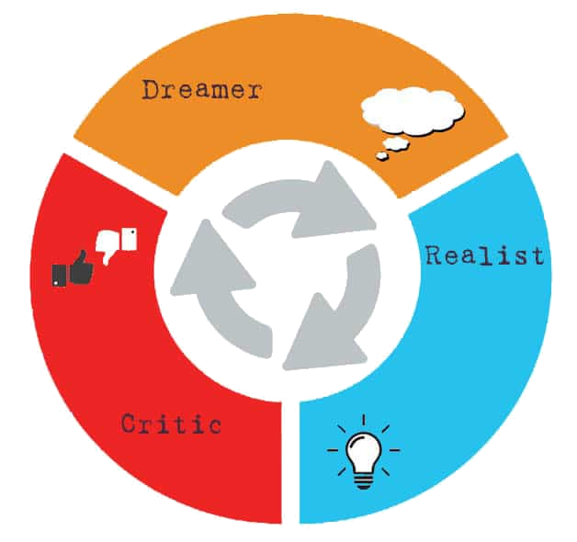
Meet The Walt Disney Creative Strategy
Disney’s Creative Strategy is a tool for creative thinking and was inspired by Walt Disney
Every enterprise can use this strategy to stimulate creativity
In this method, a group of people use a specific parallel thinking flow to generate, evaluate, and critique ideas, and hence solve problems
The strategy is based on three main streams:
What do we want?
What is the solution?
How do we imagine the solution?
What are the benefits of applying this solution?
1. Dreamers
How can we apply this idea in reality?
What is the action plan to apply the idea?
What is the timeline to apply this idea?
How do we evaluate the idea?
Each stream asks specific
questions
2. Realists
What could be wrong with the idea?
What is missing?
Why can we not apply it?
What are the weaknesses in the plan?
3. Critics
Source: https://www.designorate.com/disneys-creative-strategy/
https://t2informatik.de/en/smartpedia/walt-disney-method/

Slide 17

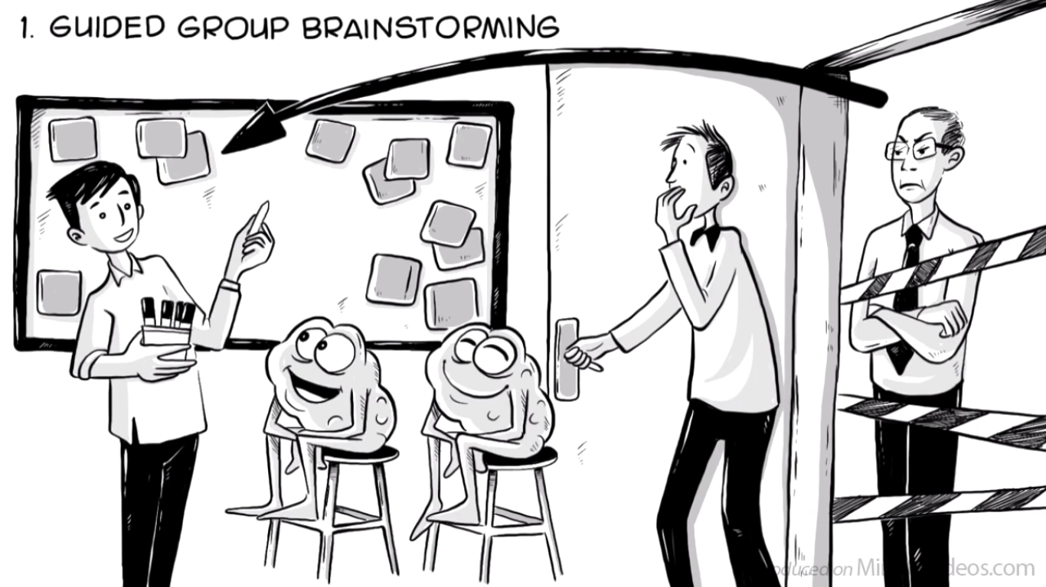
Brainstorming is an enabling technique for finding a solution to a specific problem by gathering a list of ideas spontaneously contributed by individuals
The most popular mechanism to generate these creative ideas is the brainstorming session
Brainstorming is a common and effective creativity tool
Rules of brainstorming:
High quantity of ideas leads to quality (the more ideas the better)
Criticism should be abolished (participants are not allowed to express any judgement)
The wilder idea, the better (regardless of how unrealistic an idea may seem)
Build solutions on other people’s ideas
Managers, CEOs are not allowed in the room where brainstorming is being conducted
WATCH – Brainstorming Techniques
Source: P. Dawson, C. Andriopoulos, Managing Change, Creativity and Innovation
Source: https://www.youtube.com/watch?v=YXZamW4-Ysk

Slide 18

Advantages and disadvantages of brainstorming
Advantages |  | Disadvantages
generating hundreds of ideas impressing clients improving morale helping with better understanding of each other giving enjoyment leading to personal growth and well-being thinking-up improvements helping with generate new ideas without incurring high financial outlays |  | generating of ideas without screening them this process sometimes fails to resolve the issues
Source: P. Dawson, C. Andriopoulos, Managing Change, Creativity and Innovation

Slide 19
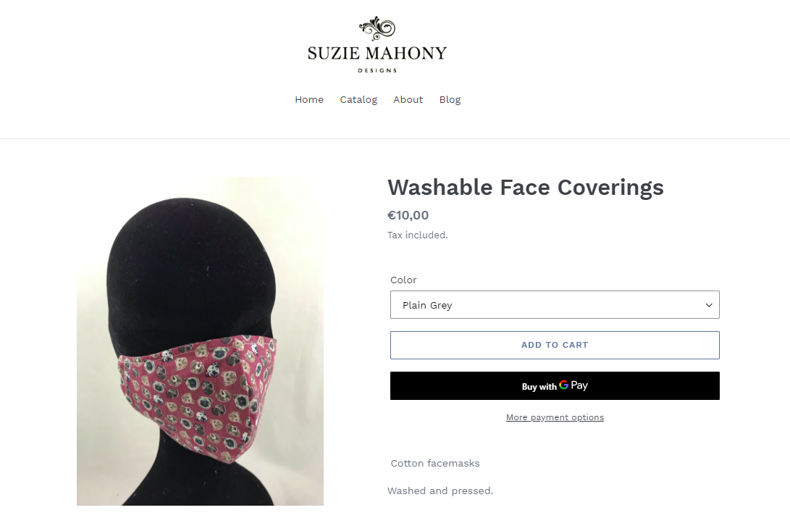
Suzy Mahony Award Winning Milliner – case study
Suzie Mahony designs high quality headpieces and hats for all occasions
In early Spring/Summer 2020 in Ireland, a country wide lock down was enforced to help stop the spread of Covid19
With no special occasions, race meetings or weddings for people to go to, Suzie’s business virtually disappeared over night
So she repurposed her seamstress and sowing skills to start handcrafting unique and fashionable cotton face coverings and started selling them on her website
Suzie completely changed her product focus from award winning millinery to the production of PPE
Her move to the production of PPE is a great example of a lean innovation since Suzie already had all the skills and equipment she needed to make these new products
Source: https://suziemahonydesigns.com/

Slide 20



Sources:
Websites:
Videos:
Other sources:
https://www.prawo.pl/kadry/dlaczego-skrzynka-pomyslow-juz-nie-wystarczy,279443.html
https://artgym.com/neuroscience-and-creativity/
https://szkolenia.avenhansen.pl/szkolenia-zamkniete/trening-tworczego-myslenia.html
https://theheart.tech/inspirations/5-ways-to-develop-team-creativity
https://www.roberthalf.com/blog/management-tips/7-elements-of-a-highly-creative-work-environment
http://www.obserwatorfinansowy.pl/forma/analizy/wygraja-banki-ktore-zdobeda-serca-i-umysly-klientow/?wpmp_switcher=desktop
https://www.designorate.com/disneys-creative-strategy/
https://t2informatik.de/en/smartpedia/walt-disney-method/
https://suziemahonydesigns.com/
https://www.youtube.com/watch?v=NugRZGDbPFU
https://www.youtube.com/watch?v=w50-Kwn8MLY
https://www.youtube.com/watch?time_continue=464&v=Mtjatz9r-Vc&feature=emb_logo
https://www.youtube.com/watch?v=YXZamW4-Ysk
J. Lichtarski, M. Trenkner, On the co-existence of innovation and creativity in the lean management environment
A. Wojtczuk-Turek, Rozwijanie kompetencji twórczych\
S.J. Parnes, Optimize the magic of your mind
N. Thomas, Kreatywność i innowacje według Johna Adaira
T.M. Amabile, Motivating creativity in organization: On doing what you love and loving what you do
G.D. Hughes, Add creativity to your decision process
J. Miller, M. Wroblewski, J. Villafuerte, Kultura kaizen
P. Dawson, C. Andriopoulos, Managing Change, Creativity and Innovation

Slide 21

Use brainstorming technique to suggest more creative ideas of products that would be useful during Covid-19 pandemic
Shout out solutions to the problem - write them down on a white board or flip-chart
Remember - there must be absolutely no criticising of ideas
Select the five ideas which you like best
Write down no more than five criteria for judging which ideas best solve the problem
Give each idea a score of 0 to 5 points depending on how well it meets each criterion
The idea with the highest score will best solve your problem
The duration of the exercise (in groups) is 45 minutes.
Task

Slide 22

"If we want tomorrow to be better than today, we only have one way: we have to be more creative"

