Slide 1

Module 9:
Is it worth implementing
Lean Innovations?
How to evaluate innovation

Slide 2
LEAN EVALUATION
Lean evaluation can give You valuable feedback without spending too much time on gathering and analysing data

Slide 3
1. LEAN EVALUATION
Validated learning
Real metrics
Pivot or persevere?
Continuous testing and iteration
Innovation accounting
create learning experiments, where teams follow a continuous cycle of ‘build-measure-learn’
choosing key metrics that enable you to track and measure what really matters: user engagement with the product, assumption-testing, and current product value
build experiments around “real” metrics, rather than ”vanity” metrics
“pivot” means changing direction without totally abandoning previous learning or product vision
doing real-time user testing, finding out what the customer really wants and making business decisions following user feedback
1. The principles of lean evaluation:

Slide 4
2. Innovation accounting
The most important while evaluating new ideas
2. INNOVATION ACCOUNTING
Innovation accounting
allows a team to:
    Build a model of customer behaviour over time
    Use that model to change the product/service and change customer behaviour
    Ergo, establish facts about validity of the vision and if it is sustainable
The three major learning milestones in innovation accounting are:
Building an MVP and establishing a baseline and feedback loop with customers
Run experiments on the MVP to move from baseline customer behaviour to ideal customer behaviour
Decision point — persevere or pivot, based on what has been learned

Slide 5

The innovation accounting process
2. INNOVATION ACCOUNTING
1. Choose your metrics
The key is to keep metrics simple and easy to use
If you’re wondering where to start, the above first level examples may provide an entry point
Or you can prompt ideas by asking yourself these questions and then refining the answers into metrics for which the data is available:
Did we do what we said we would?
How are people working differently?
Do users see an improvement? (referring back to the original problem or need that your product is an attempt to solve)
What new sources of growth are we tapping?
Source: https://www.boldare.com/blog/lean-startup-innovation-accounting/

Slide 6


The innovation accounting process
2. INNOVATION ACCOUNTING
2. Monitor the data
Apply your chosen metrics to the three levels
Gather the data and measure progress
3. Hold the project to account
Act on the data you have
Is the project team performing to plan?
What progress is being made, and in what direction?
Is the product development still aligned to identified user needs?
Source: https://www.boldare.com/blog/lean-startup-innovation-accounting/

Slide 7
The main role of innovation metrics is to make sure you’re doing enough of the right activities to reach your goals
They are typically divided into two different categories: input metrics and output metrics
In other words: what goes into your innovation process and what comes out of it
3. INPUT VS. OUTPUT METRICS
3. Input vs. Output metrics

Slide 8
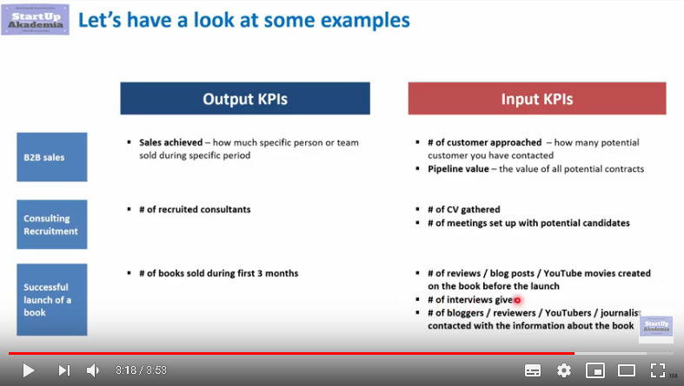

3. INPUT VS. OUTPUT METRICS
You can compare Input vs. Output metrics
Input metrics… | Output metrics…
…are used for measuring your investments: | …are used for measuring your returns:
Money spent for designing/testing new or improved product as a percentage of sales The number of innovation projects started The number of new ideas in the pipeline Number of new employees that need to be included in the design/testing phase of a new/improved product | Number of new products launched in X amount of time Revenue/profit growth from new products ROI (return on investment) of innovation activities Actual vs. targeted break-even time for new products
Watch “What is the difference between Input KPIs vs Output KPIs”
(4.0mins)
You Tube Link

Slide 9
REMEMBER!
To get a more complete picture, it’s best to use a mixture of input and output metrics!
3. INPUT VS. OUTPUT METRICS
For example, rather than simply measuring how much money we have spent during the design/testing phase (an input metric), you should measure this spend against the revenue generated by products recently released to the market
This combined approach helps to tell both sides of the story:
the investments a company is making in innovation, and the results of these investments over time

Slide 10
Value Metrics
4. LEAN INNOVATION KEY METRICS
4. Lean innovation key metrics
Acquisition. How do users find out?
Activation. Do users have a great first experience?
Retention. Do users come back?
Revenue. How do You make money?
Referral. Do users tell others?

Slide 11
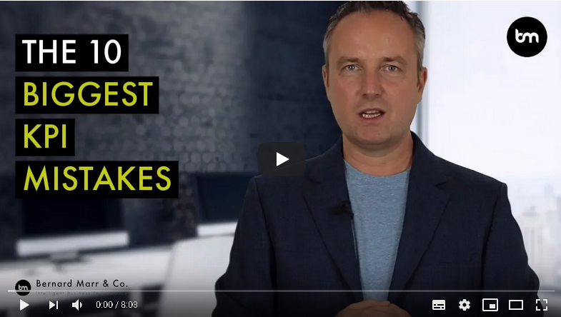
Financial KPIs
4. LEAN INNOVATION KEY METRICS
If You want to concentrate only on finance – use financial KPI’s
Ideation ratio - Sum total of the potential value of all creative ideas
Implementation ratio - Sum total of the actual implemented impact from all creative ideas
Explanation & worked example
Watch
“The 10 Biggest mistakes companies make with KPIs (Key Performance Indicators)”
You Tube Link
I
(8.0mins)

Slide 12
4. LEAN INNOVATION KEY METRICS
REMEMBER!
Try not to use too many different metrics !
Using too many different metrics can result in a confused and inconsistent picture of company innovation
So, start off nice and easy, get the right people on board, and pick just a handful of innovation KPIs to begin with
Your staff will thank you
Once you’ve found an approach that works, stick with it!
Sticking with one measurement approach over time will ensure your results are standardised and can be compared between quarters
Stick with something long enough, and you’ll be able to tell a convincing story of your innovation trends

Slide 13
But which innovation metrics and KPIs should you use?
4. LEAN INNOVATION KEY METRICS
You should choose metrics that are consistent with your innovation strategy, and which match the areas of investment focus for the upcoming years. Consider these factors, and develop your own “metrics mashup” covering the areas of company creativity that matter most to you.
To ensure you capture all elements of innovation, it is recommended to use following metrics and KPIs:
The overall percentage of revenue generated from recent innovations (for example, products released to market in the last two to three years)
The percentage of staff time (including executive time) spent on high-yield innovation activities (in other words, creative efforts resulting in innovations with market potential)
The number of innovative projects progressing through project milestones each quarter

Slide 14

5. Methods of evaluation
5. METHODS OF EVALUATION
Scored SWOT analysis
This SWOT analysis approach includes a scoring system in which reviewers give 0 to 5 points each for strengths and opportunities, and take away 0 to 5 points each for weaknesses and threats
This provides a SWOT metric which can be handy for comparing large numbers of ideas
Strengths
Weaknesses
SWOT
Threats
Opportunities
Watch “Business strategy - SWOT analysis”
You Tube Link
(3.0 mins)

Slide 15
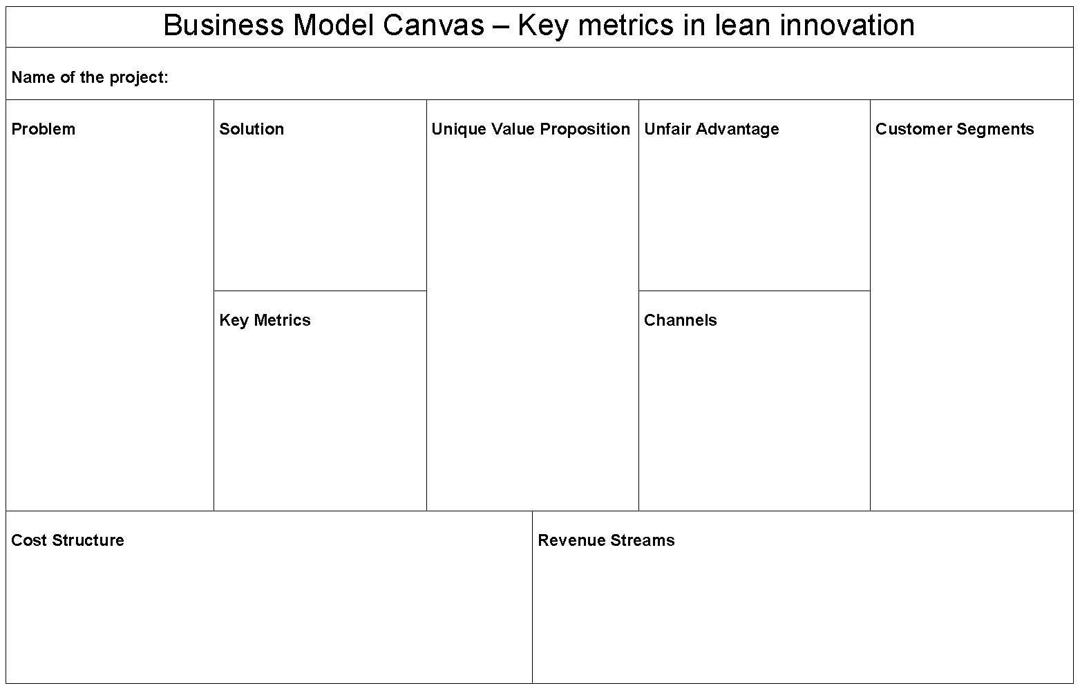
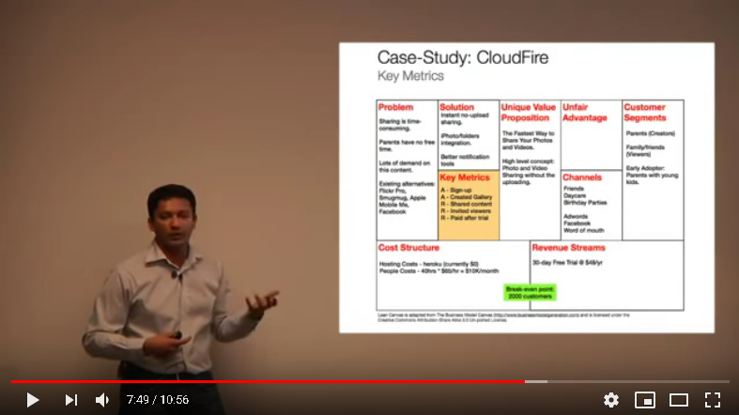
Business Model Canvas
5. METHODS OF EVALUATION
Watch “21 Lean Startup Key Metrics”
You Tube Link
(11.0 mins)

Slide 16
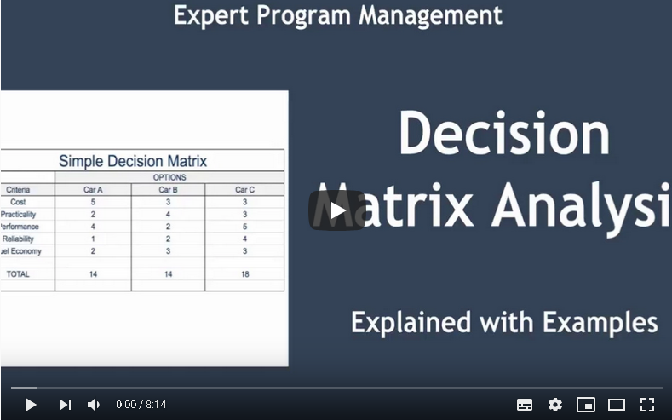
5. METHODS OF EVALUATION
Evaluation matrix
is a simple array in which experts compare an idea with a set of criteria. In our experience, five criteria is best as it allows for a rounded review without bogging the evaluators down in unnecessary detail. The evaluator ranks how well the idea meets each criterion (we use a scale of 0-5 points for each criterion).
Evaluators are also encouraged to provide comments elaborating on their ratings and, in particular, suggesting how the idea might be improved to overcome weaknesses. The evaluation matrix provides a criterion by criterion score as well as an overall score for each idea.
Assuming several ideas focusing on a particular problem or business issue are being evaluated at the same time, these scores can be compared, and the highest scoring ideas can be selected for further review.
The detailed description of the procedure is here:
You Tube Link
You can find the evaluation matrix step-by-step guide in the Module 9 Notes
(8.25 mins)

Slide 17
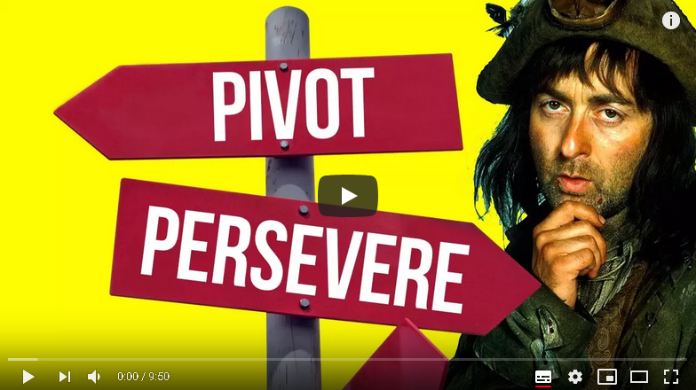
6. Pivot or Persevere?
6. PIVOT OR PERSEVERE?
Pivoting is what you should consider when you come to the conclusion that you’re not making any progress (or not enough) toward product/market fit. A pivot is a radical course correction, going in a new direction, with a new hypothesis about your product, strategy and business model.
In Pivot Mode, your unit of progress is creative destruction. You have successfully pivoted when you have re-imagined what your company is for. Your reinvented business doesn’t look at all like the previous one. Therefore, a pivot is something that happens only a few times in the life of the average company.
Persevering with your current business strategy means that you keep believing in what you set out to achieve, only you will implement small changes and updates every day to make progress toward your goals.
Using ongoing build – measure - learn cycles, you try to move the drivers of the business model in the direction of a favourable outcome.
Watch “The Lean Startup - Time to Pivot... or Persevere?
You Tube LInk
(10.0 mins)
https://medium.com/swlh/pivot-patch-or-persevere-i-patched-the-lean-startup-206d63023b9c

Slide 18
Types of pivot
6. PIVOT OR PERSEVERE?
1. Zoom-in pivot. This pivot can be useful when you see that one feature in your product gets far more traction and interest than the other features in your product. You can then "pivot" by offering a new product that offers only that one feature.
2. Zoom-out pivot. This is the above pivot in reverse. You broaden your product to include more features. Now what was considered the whole product becomes one (or several) features of a larger product.
3. Customer segment pivot. Your product may prove popular but not with the user segment that you had initially targeted. Therefore your product positioning may need to change and the value proposition, pricing, and channels would all need to be reviewed.
4. Customer need pivot. Imagine you use the Lean Startup framework to identify early on that the problem you are trying to solve with your product is not very important to customers. Then you must understand more deeply the job that they are trying to do and find a problem they are willing to pay you to solve.
5. Platform pivot. This talks about a change from an application to a platform or vice versa. Examples of platforms are eBay, AirBnb, Uber, Android store etc.
Source: https://openclassrooms.com/en/courses/4544561-learn-about-lean-startup/4716471-learn-how-and-when-to-pivot

Slide 19
Types of pivot
6. PIVOT OR PERSEVERE?
6. Business architecture pivot. There are two types of business: high-margin, low-volume and low-margin, high-volume. You cannot be both, but sometimes you can pivot from one to the other.
7. Value capture pivot. This pivot refers to changes in how you monetise or earn revenue. When you change how you make money, this impacts the product, business, sales, marketing and operational sides of the business model.
8. Engine of growth pivot. Viral growth is when current users recommend other users. Paid growth is when you spend marketing money on acquiring new customers. Sticky growth is when you manage to retain most of your users and churn rate is low. You can pivot from one of these growth engines to another.
9. Channel pivot. Here you change how and where you sell your products and services (in stores, online, through partners, in-app).
10. Technology pivot. This pivot is when a new technology can be used to achieve the same outcome. This can be beneficial if the new solution has a lower cost and/or better performance.

Slide 20
The Early Pivot of Twitter
6. PIVOT OR PERSEVERE?
Twitter actually had a different company name to begin with: "Odeo". In 2005, their product was a podcast service. Users could create podcasts, but also find and subscribe to them.
However, the same year, Apple announced that iTunes would include a podcasting platform in all iPods. Odeo was never going to successfully compete with Apple. So its 14 employees started to brainstorm ideas and look for new directions.
One employee, Jack Dorsey, came up with an idea to build a product for group SMS (texts). Customers could update their status to a group of friends via SMS (text) and see a timeline of their status changes.
Source: https://openclassrooms.com/en/courses/4544561-learn-about-lean-startup/4716471-learn-how-and-when-to-pivot

Slide 21
Thank You and keep innovating !
6. PIVOT OR PERSEVERE?
Remember!
The primary engine for keeping the learning process moving forward is the Build-Measure-Learn feedback loop
The faster a team can go through the loop, the faster they can learn, and theoretically, the faster they can create a sustainable business

